Slide 1
Visualizing associations
HUGEN 2073
Genomic Data Visualization and Integration
Slides borrowed/adapted from H.J. Park with permission

Slide 2
Some statistical tests for associations/trends… … and some natural complementary visualizations

Slide 3
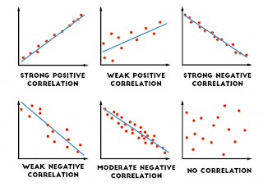
Visualizing correlations
Correlation is a linear relationship
https://medium.com/@dipti.rohan.pawar/correlation-statistical-analysis-9471411f0431

Slide 4
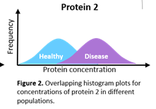
Visualizing a difference in means
Group mean difference implies difference in two distributions
https://raybiotech.com/learning-center/t-test-anova/

Slide 5
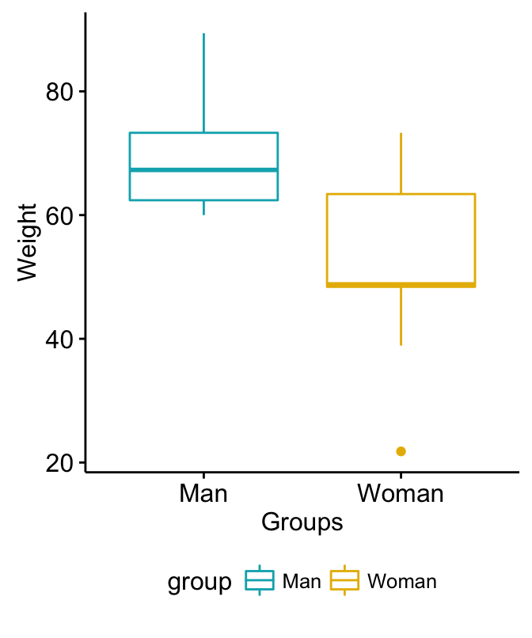
Visualizing a difference in means (or medians)
Group mean difference implies difference in two distributions
Protein concentration
Disease
Healthy
Adapted from http://www.sthda.com/english/wiki/unpaired-two-samples-t-test-in-r

Slide 6
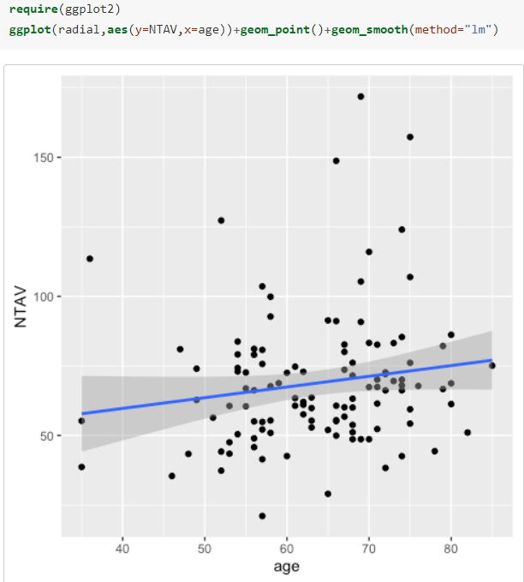
Visualizing a regression
Linear regression implies linear relationship
https://cran.r-project.org/web/packages/ggiraphExtra/vignettes/ggPredict.html

Slide 7
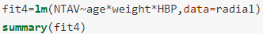
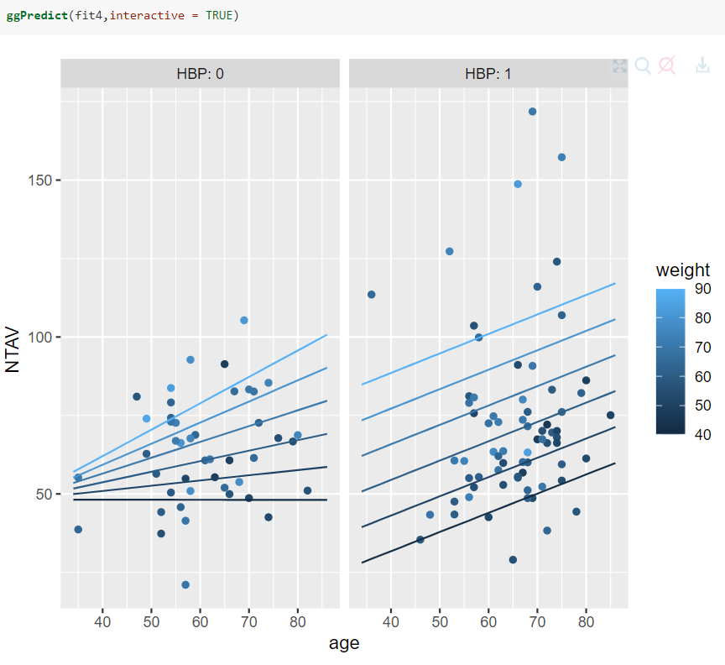
Visualizing (multivariate) regression
Linear regression with three independent variables
The third independent variable can be encoded in color
https://cran.r-project.org/web/packages/ggiraphExtra/vignettes/ggPredict.html

Slide 8
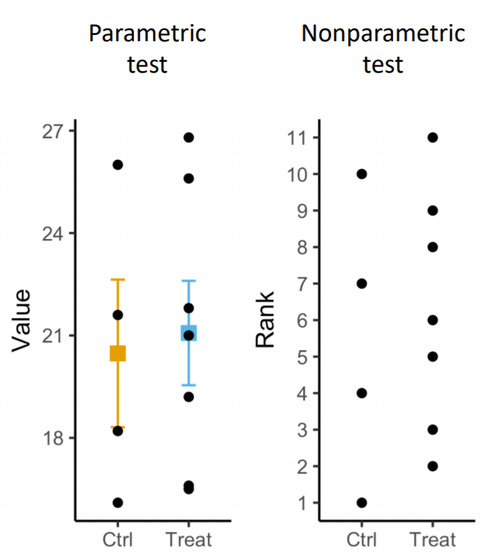
Visualizing non-parametric analyses
http://www.compbio.dundee.ac.uk/user/mgierlinski/talks/pvalues2/p-values5.pdf

Slide 9

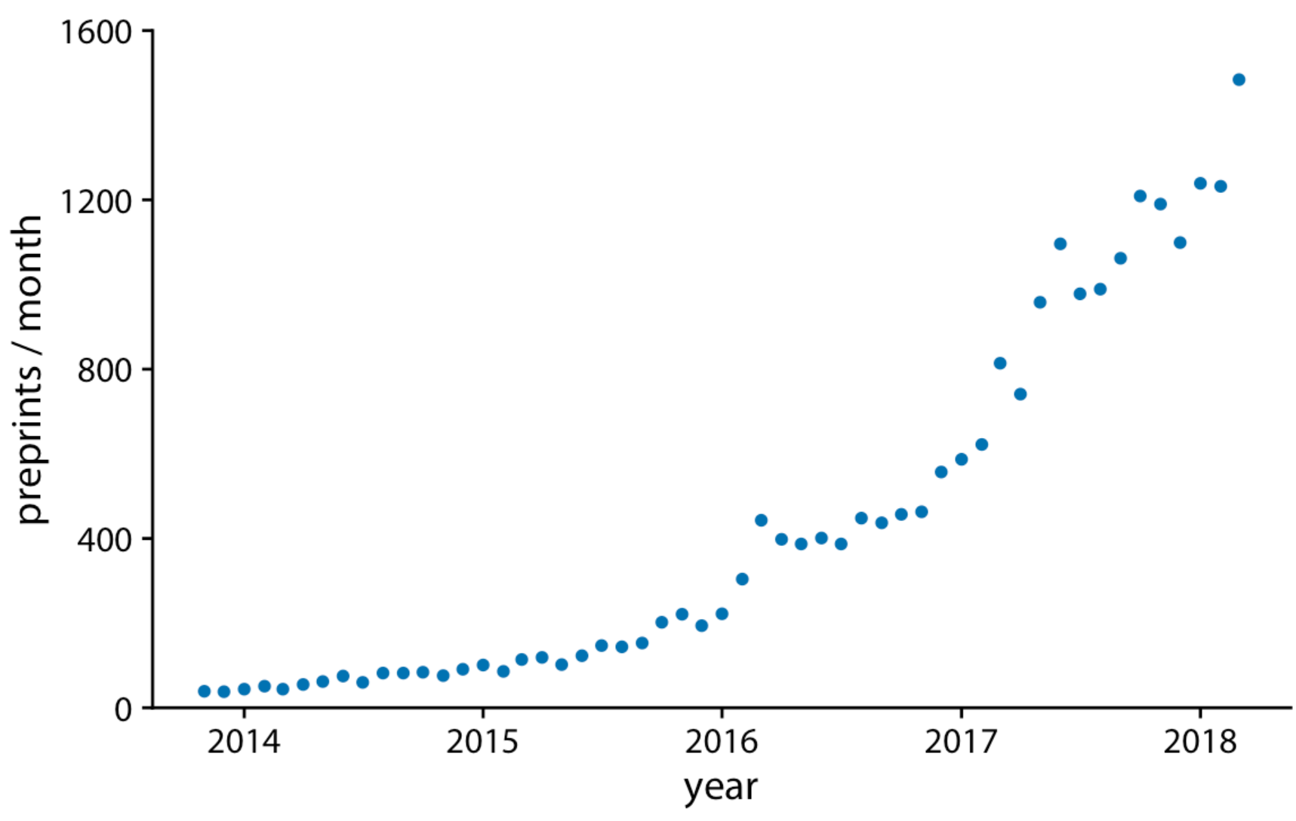
Scatterplots can show trends
Scatterplot
Plots the combination of x-/y-axis values
Can also represent the relationship across the x-axis
Submissions to bioRxiv
Fundamentals of Data Visualization, Wilke, O’Reilly, 1st Ed.
Notes:
The preceding chapter discussed scatter plots, where we plot one quantitative variable against another. A special case arises when one of the two variables can be thought of as time, because time imposes additional structure on the data. Now the data points have an inherent order; we can arrange the points in order of increasing time and define a predecessor and successor for each data point. We frequently want to visualize this temporal order and we do so with line graphs. Line graphs are not limited to time series, however. They are appropriate whenever one variable imposes an ordering on the data. This scenario arises also, for example, in a controlled experiment where a treatment variable is purposefully set to a range of different values. If we have multiple variables that depend on time, we can either draw separate line plots or we can draw a regular scatter plot and then draw lines to connect the neighboring points in time.
As a first demonstration of a time series, we will consider the pattern of monthly preprint submissions in biology. Preprints are scientific articles that researchers post online before formal peer review and publication in a scientific journal. The preprint server bioRxiv, which was founded in November 2013 specifically for researchers working in the biological sciences, has seen substantial growth in monthly submissions since. We can visualize this growth by making a form of scatter plot (Chapter 12) where we draw dots representing the number of submissions in each month (Figure 13.1).

Slide 10
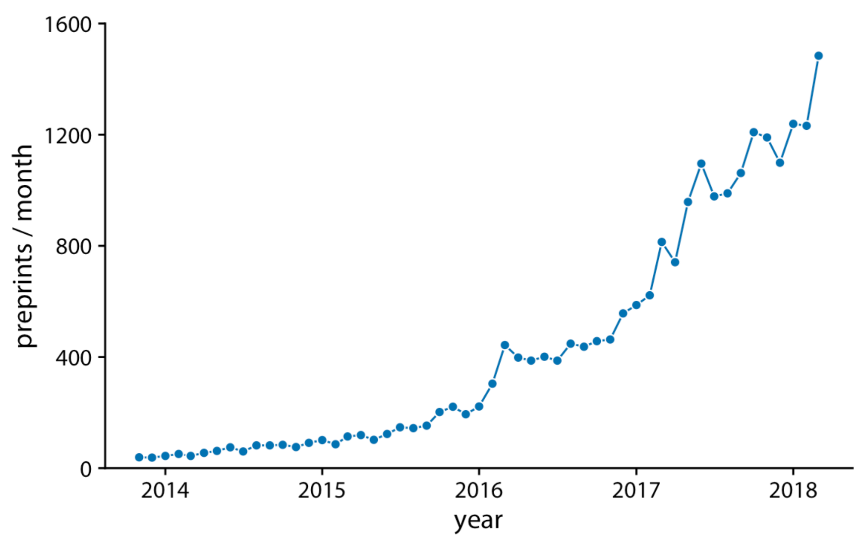
Line graphs are often better
Submissions to bioRxiv
Like scatterplot:
Data plotted against x-/y-axis
Unlike scatterplot: Dots
Have exactly one left and right neighbor
E.g., time points or in a controlled experiment where a treatment is set to different values
Fundamentals of Data Visualization, Wilke, O’Reilly, 1st Ed.
Notes:
This is a line graph showing the number of preprints in every month each year.
You may think of it as a type of scatterplot, since data points are plotted with x-axis and y-axis like scatterplot.
There is an important difference however between Figure 13.1 and the scatter plots discussed in Chapter 12. In Figure 13.1, the dots are spaced evenly along the x axis, and there is a defined order among them. Each dot has exactly one left and one right neighbor (except the leftmost and rightmost points which have only one neighbor each). We can visually emphasize this order by connecting neighboring points with lines (Figure 13.2).

Slide 11
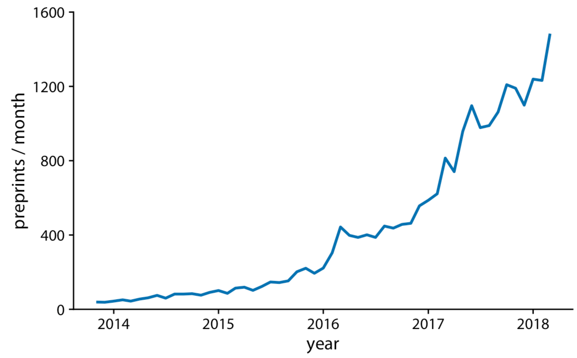
A line graph without datapoints?
Submissions to bioRxiv
Pros: less busy
Cons: lack of actual data points
OK to use if
Data points are dense
You want to emphasize trend
Fundamentals of Data Visualization, Wilke, O’Reilly, 1st Ed.

Slide 12
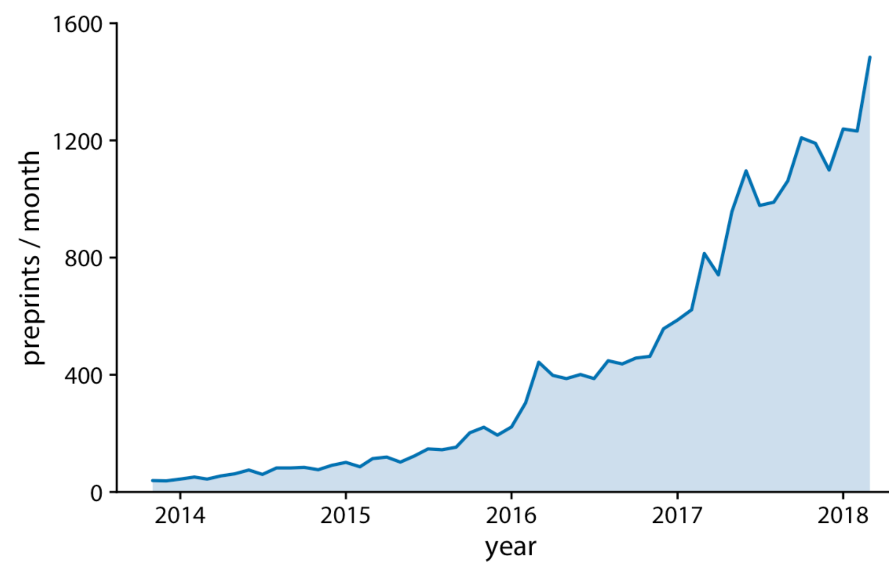
Shaded line graph to further highlight a trend?
Submissions to bioRxiv
Shaded area perceived to be more “real” or physical?
To represent “physicality”, y-axis needs to start at 0
Fundamentals of Data Visualization, Wilke, O’Reilly, 1st Ed.

Slide 13
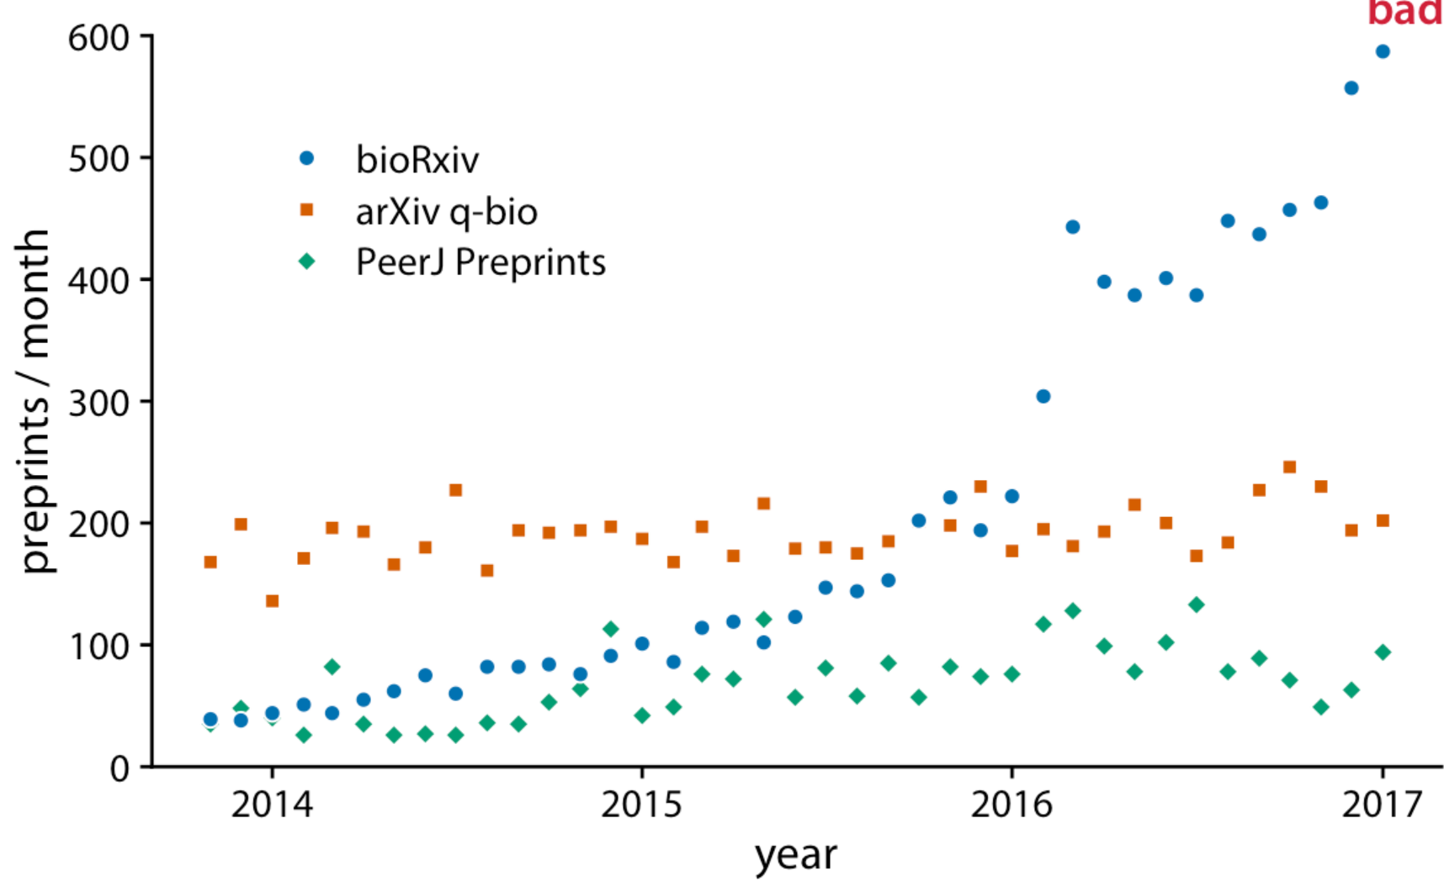
Scatterplot to show trend in multiple time-series?
Monthly submissions to three preprint servers covering biomedical research
Showing many independent data points in three groups
Fundamentals of Data Visualization, Wilke, O’Reilly, 1st Ed.
Notes:
We often have multiple time courses that we want to show at once. In this case, we have to be more careful in how we plot the data, because the figure can become confusing or difficult to read. For example, if we want to show the monthly submissions to multiple preprint servers, a scatter plot is not a good idea, because the individual time courses run into each other (Figure 13.5)

Slide 14
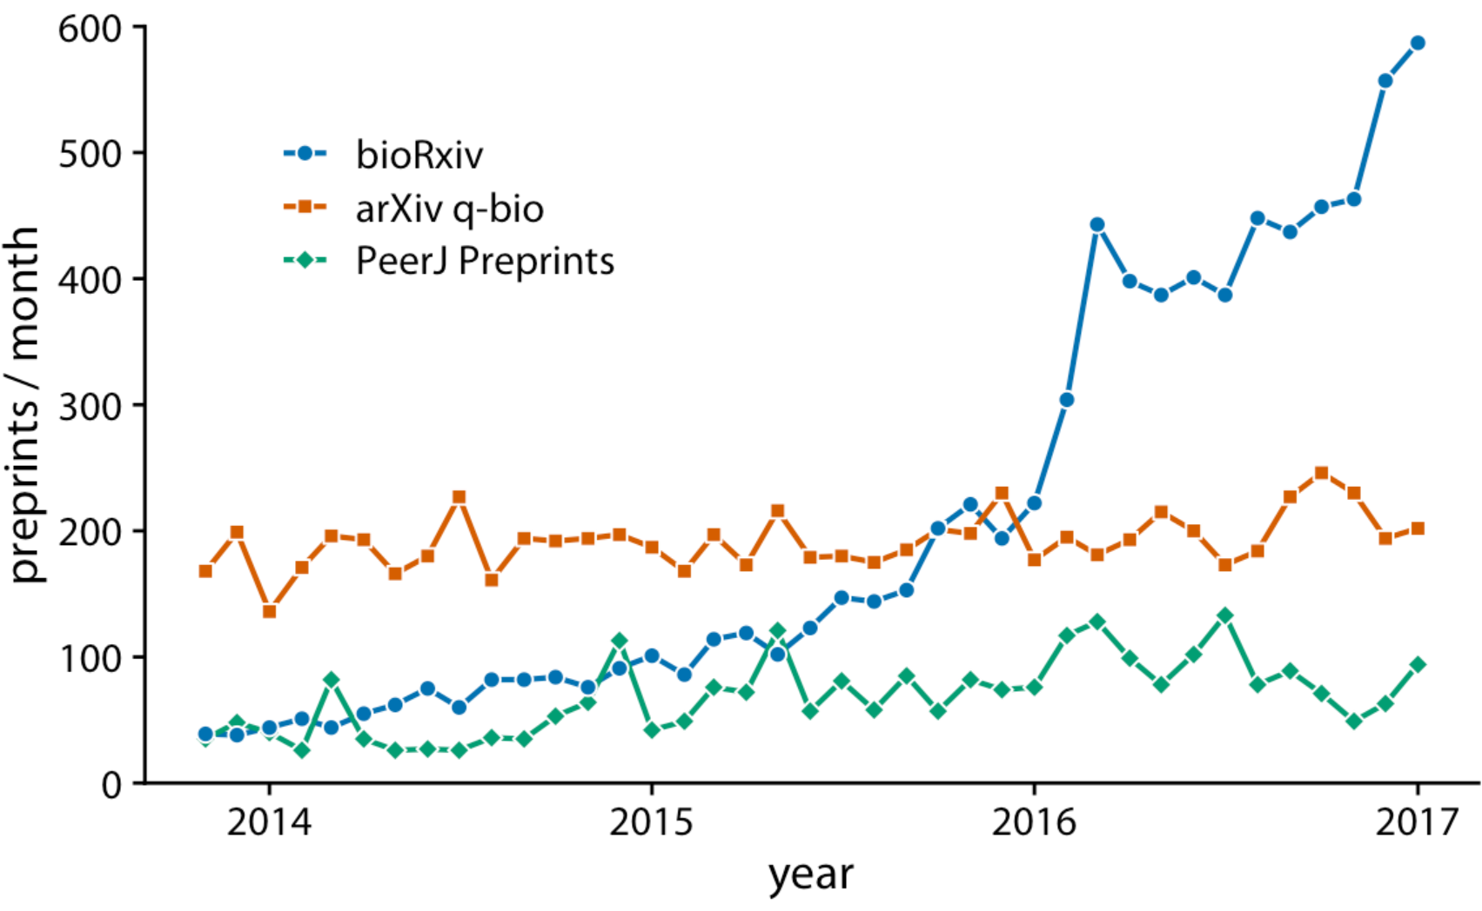
Line graph to show trend in multiple time-series
Monthly submissions to three preprint servers covering biomedical research
Showing three independent trends
Fundamentals of Data Visualization, Wilke, O’Reilly, 1st Ed.
Notes:
We often have multiple time courses that we want to show at once. In this case, we have to be more careful in how we plot the data, because the figure can become confusing or difficult to read. For example, if we want to show the monthly submissions to multiple preprint servers, a scatter plot is not a good idea, because the individual time courses run into each other (Figure 13.5)

Slide 15
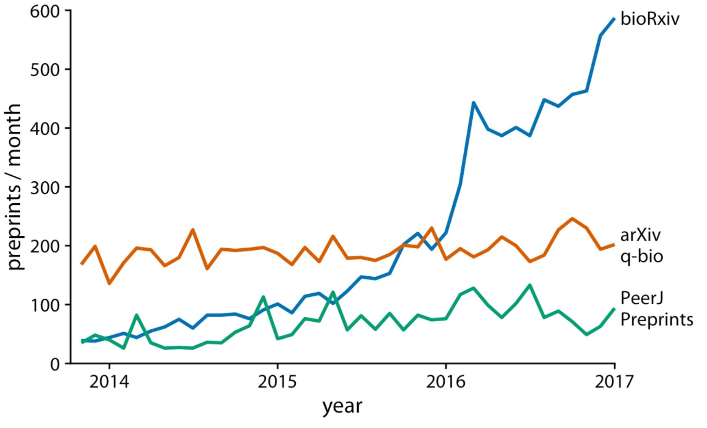
Line graph to show trend in multiple time-series
Monthly submissions to three preprint servers covering biomedical research
Improvements (?):
Data points dropped?
Legend replaced
Fundamentals of Data Visualization, Wilke, O’Reilly, 1st Ed.
Notes:
We often have multiple time courses that we want to show at once. In this case, we have to be more careful in how we plot the data, because the figure can become confusing or difficult to read. For example, if we want to show the monthly submissions to multiple preprint servers, a scatter plot is not a good idea, because the individual time courses run into each other (Figure 13.5)

Slide 16
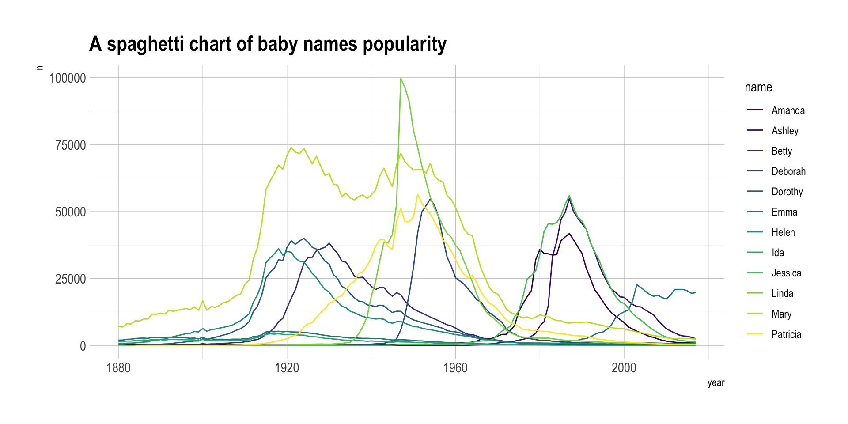
The spaghetti plot problem
Evolution of baby names in the US
Each additional trendline might not seem like “too much”
But the total effect can be a “spaghetti plot”
Difficult to locate a specific line
Occurrence
https://www.data-to-viz.com/caveat/spaghetti.html
Notes:
It is very hard to follow a line to understand the evolution of a specific name’s popularity. Plus, even if you manage to follow a line, you then need to link it with the legend which is even harder. Let’s try to find a few workarounds to improve this graphic.

Slide 17
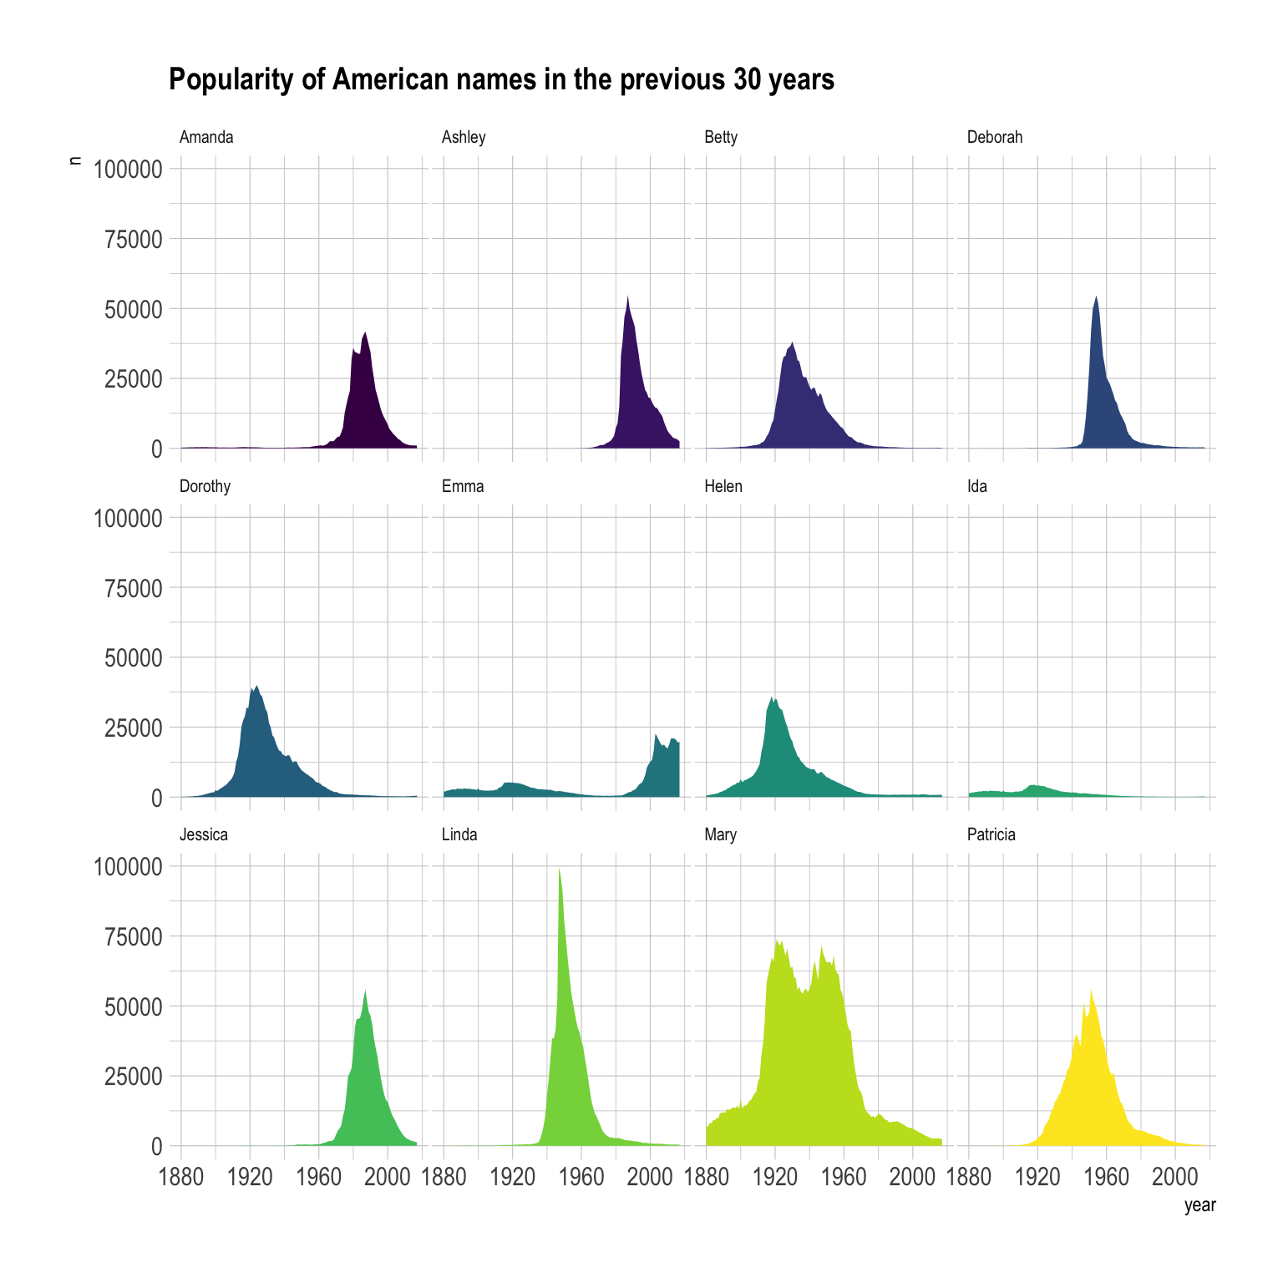
Multiples to avoid the spaghetti plot problem?
Evolution of baby names in the US
Pros:
Any trend can be easily seen in detail
Cons:
Trends can’t be directly compared
https://www.data-to-viz.com/caveat/spaghetti.html
Notes:
Area charts can be used to give a more general overview of the dataset, especially when used in combination with small multiples. In the following chart, it is easy to get a glimpse of the evolution of any name:
For instance, Linda was a really popular name for a really short period of time. On another hand, Ida has never been very popular, but was used a little during several decades.

Slide 18
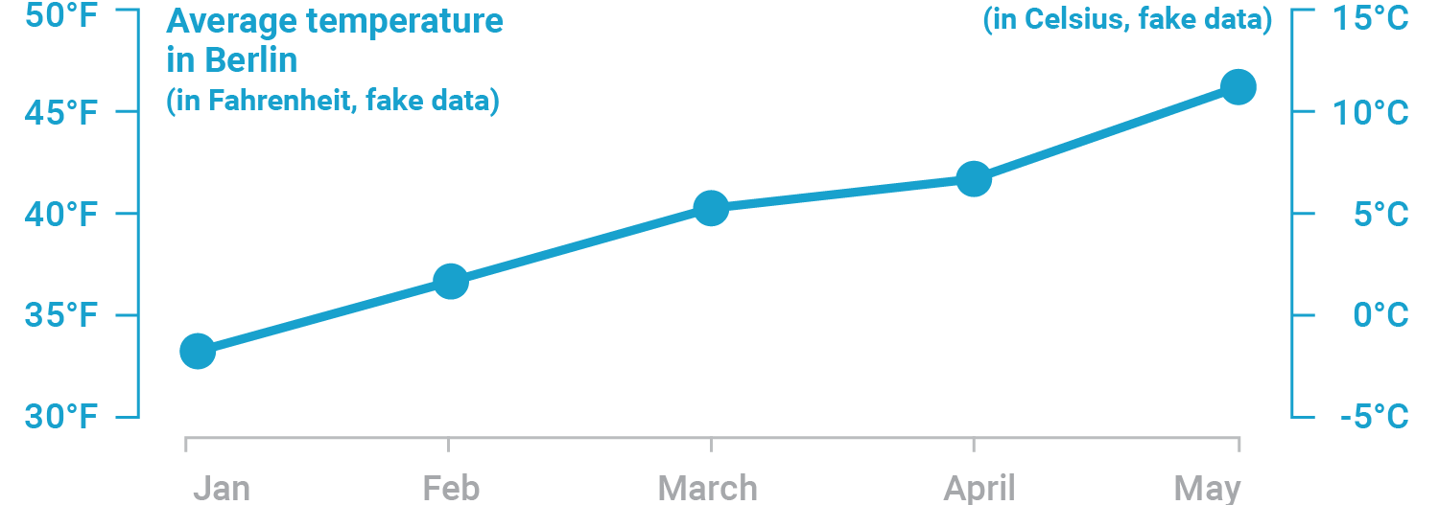
Dual axis chart to show different scale
https://blog.datawrapper.de/dualaxis/
Notes:
To start our discussion about association, let me first introduce the figures with a dual axis.
We can put dual axis on a figure for different purposes.
The first purpose would be to show different scales of the same values.
For example, e.g. the values in Fahrenheit on one axis and in Celsius on the other one:

Slide 19
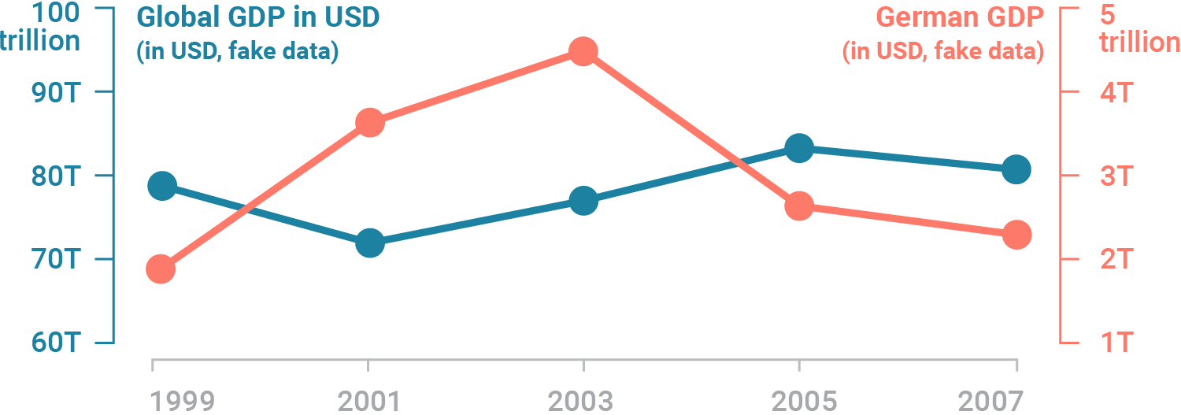
Dual axis chart can show association
Pros: helps to easily see
No association
Association
Positive
Negative
https://blog.datawrapper.de/dualaxis/
Notes:
More importantly, we can assess association of two variables using this type of figures.
For example, by plotting global GDP and german GDP together, we can visualize their association, which in this case is not that great.

Slide 20
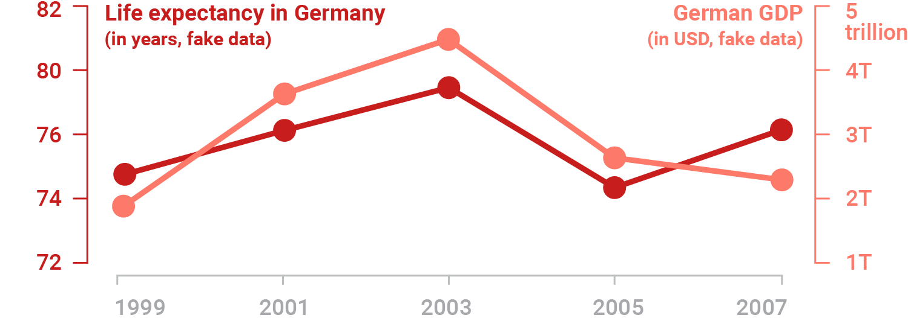
Dual axis chart can show association
Pros: helps to easily see
No association
Association
Positive
Negative
https://blog.datawrapper.de/dualaxis/
Notes:
However, life expectancy change in Germany corresponds to german GDP over the years.
As you can see, dual axis chart can show association.

Slide 21
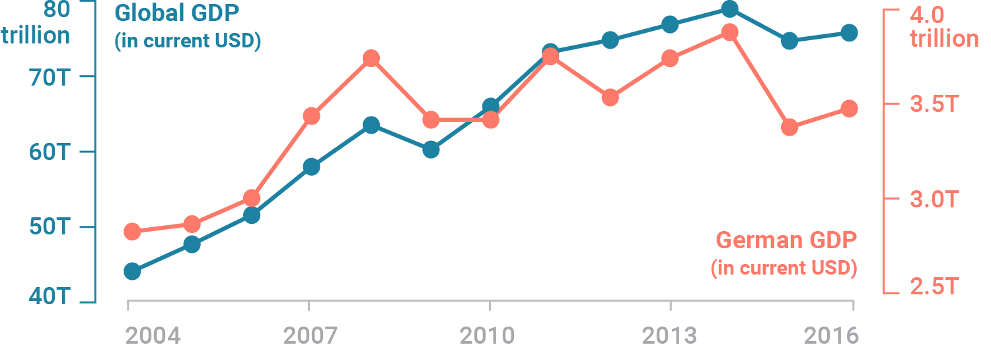
Dual axis chart can mislead
The proportions of the two scales can be different
https://blog.datawrapper.de/dualaxis/
Notes:
Let’s use some real Worldbank data for the German GDP and the global GDP between 2004 and 2016 to explain that:.
This chart has two different y-axes: The left axis shows the global GDP with a range from 40 to 80 trillion US-Dollar. The right axis shows the German GDP with a range between 2.5 and 4 trillion US-Dollar. The measure (US-Dollar) is the same, but we have a wildly different magnitude. A second axis sounds like a good solution – but there are problems we have with them:

Slide 22
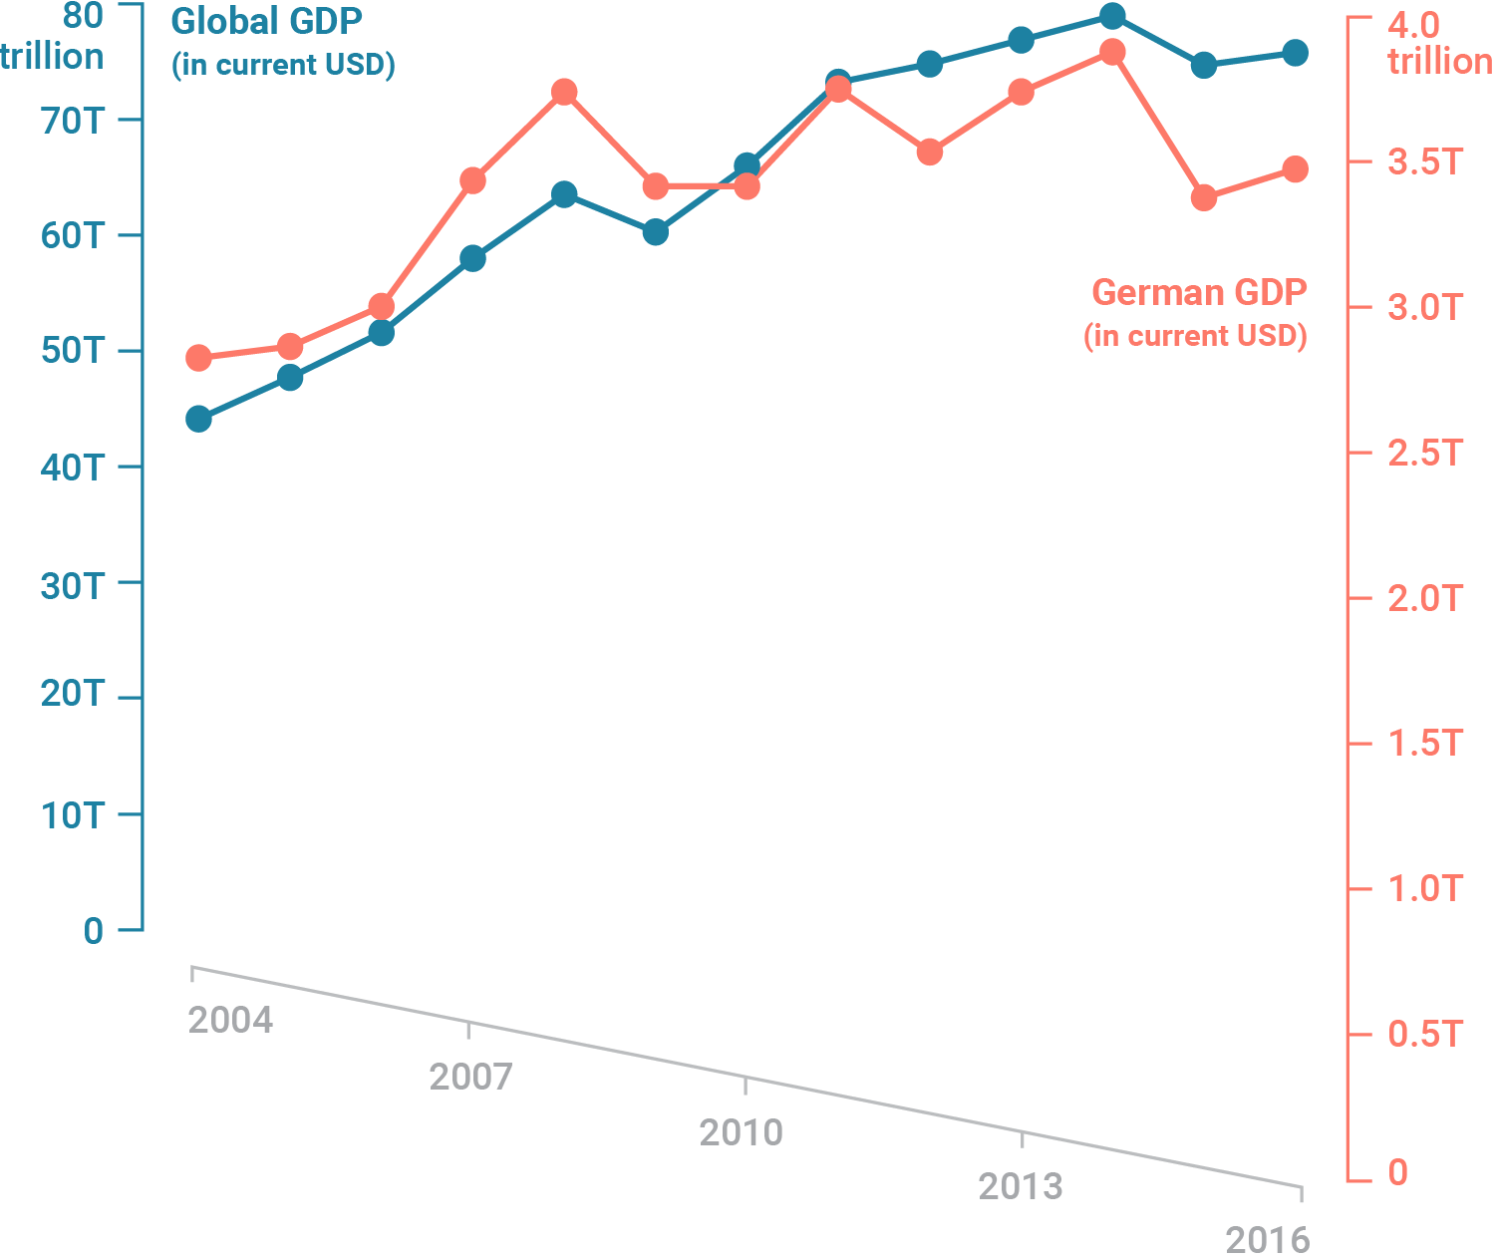
Dual axis chart can mislead
The proportions of the two scales can be different
If the axes extend down to zero, ..
https://blog.datawrapper.de/dualaxis/
Notes:
The proportions of the two scales are often different from each other in dual axis charts. If the left axis would go down to zero, the chart would be twice as long. If the right axis would go down to zero, the chart would be almost three times as long. This is how both axes look like when we extend them to zero:

Slide 23
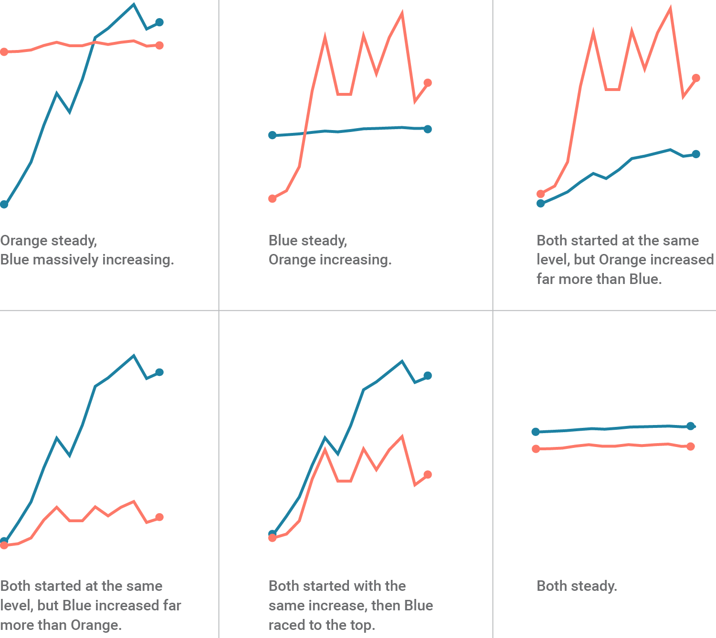
Different looks with different axes
https://blog.datawrapper.de/dualaxis/
Notes:
So how small is the relationship between these two lines? Let’s go crazy. Nothing really matters, right? We can make all kinds of statements with our two data sets if we just tweak the scales a little bit:.
But that’s a problem we can solve, isn’t it? We can just set the zero baseline to the same height. Except:
Readers need to be aware
Presenters need to respect domain knowledge
Presenters need to state clearly

Slide 24
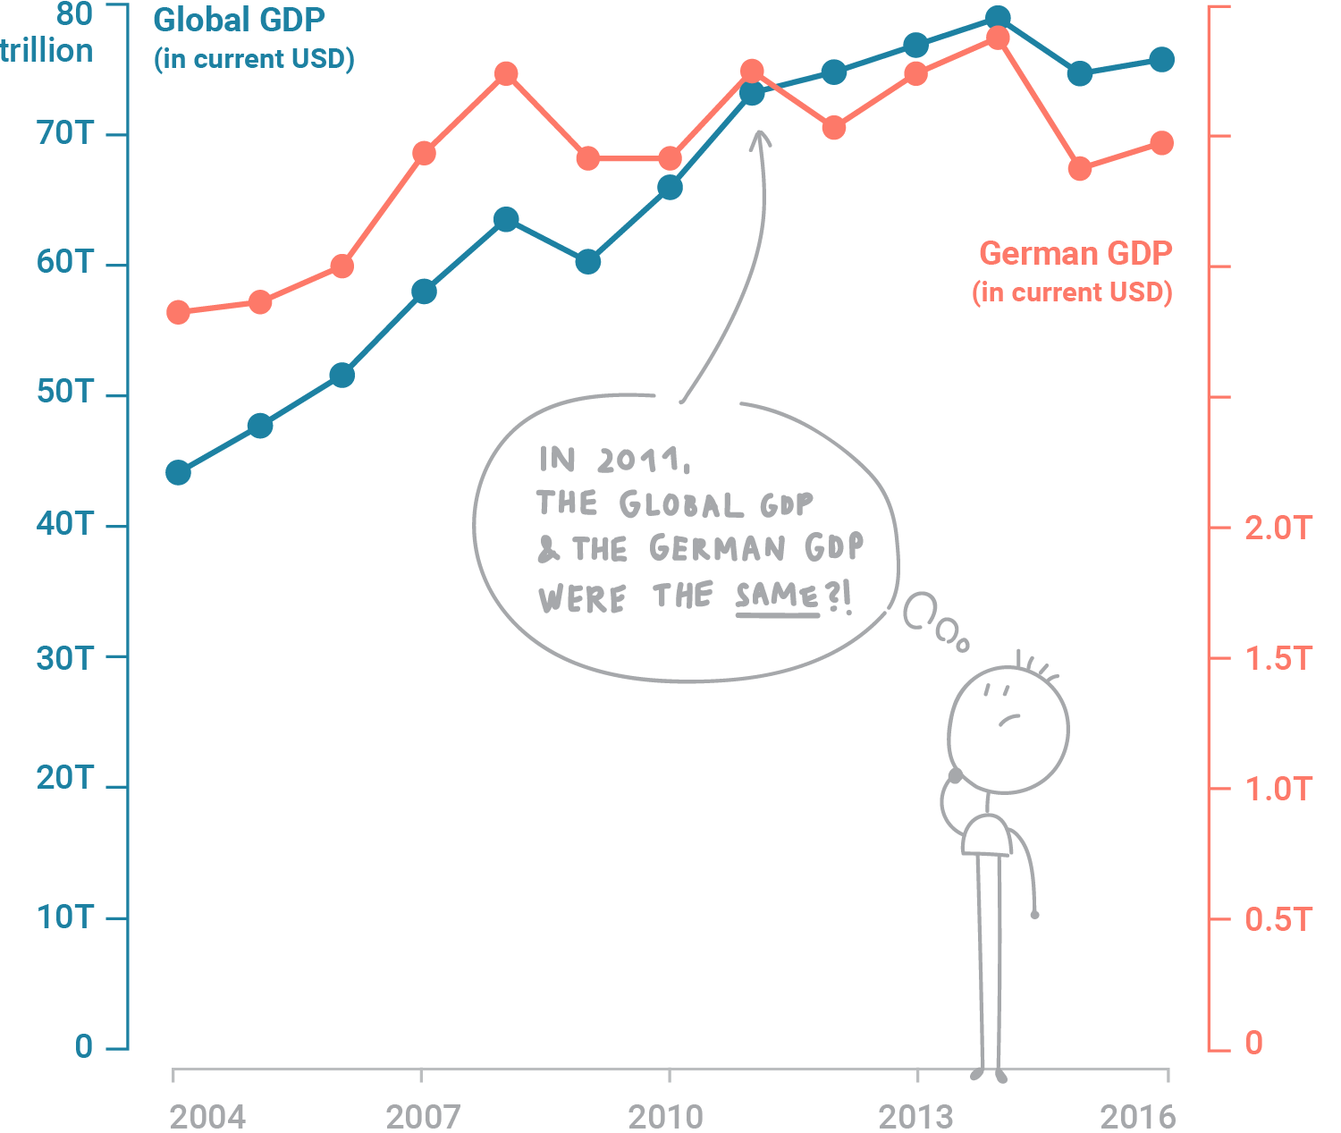
Zero baselines at the same height can mislead
Potential misinterpretations
German GDP higher until 2012? (10% of chance)
Around the same at 2012? (10% of chance)
German GDP slightly lower after then? (10% of chance)
Waste of space
Adapted from https://blog.datawrapper.de/dualaxis/

Slide 25
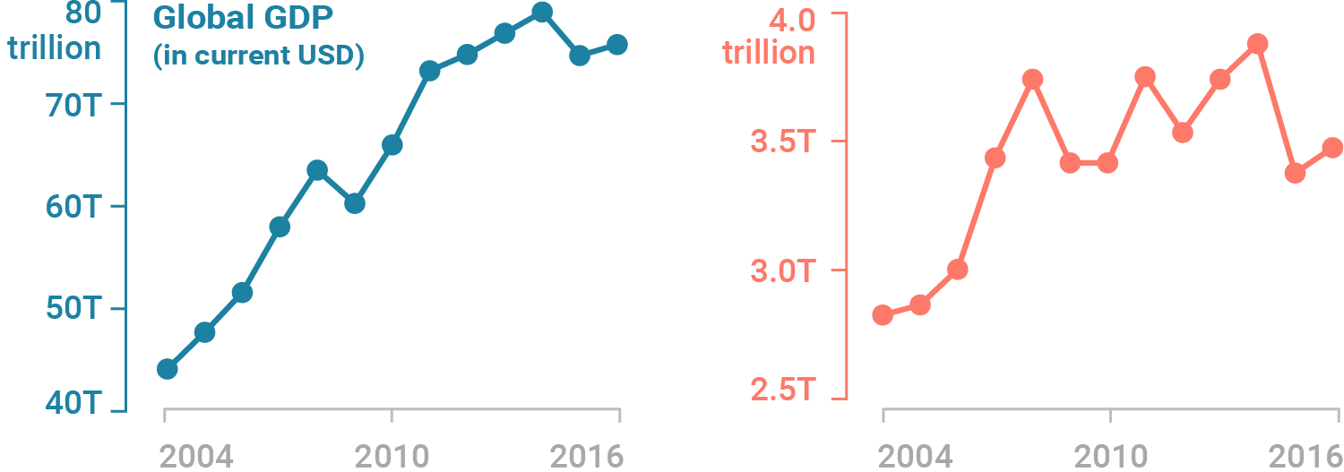
Solution 1. Side-by-side charts
Imposing independence
Adapted from https://blog.datawrapper.de/dualaxis/

Slide 26
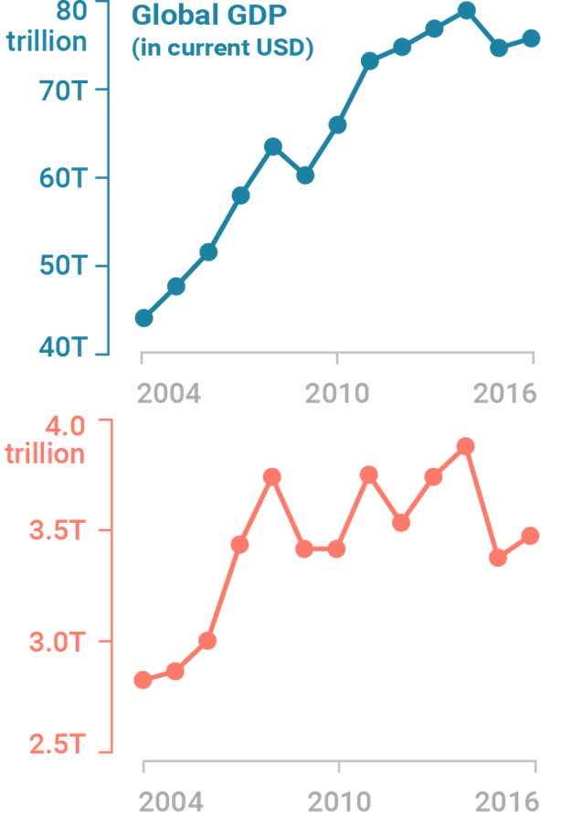
Solution 1. Side-by-side charts
Pros: better if you want to compare them by year
Adapted from https://blog.datawrapper.de/dualaxis/

Slide 27
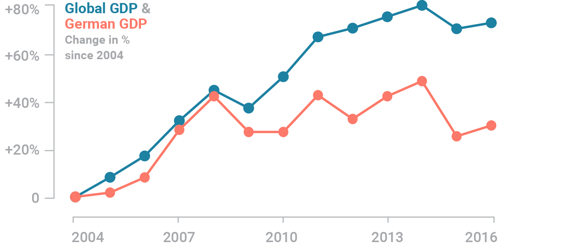
Solution 2. Indexed charts
Pros: works for data series with a similar rate of change
Cons: more indirect than the raw GDP values
Adapted from https://blog.datawrapper.de/dualaxis/

Slide 28
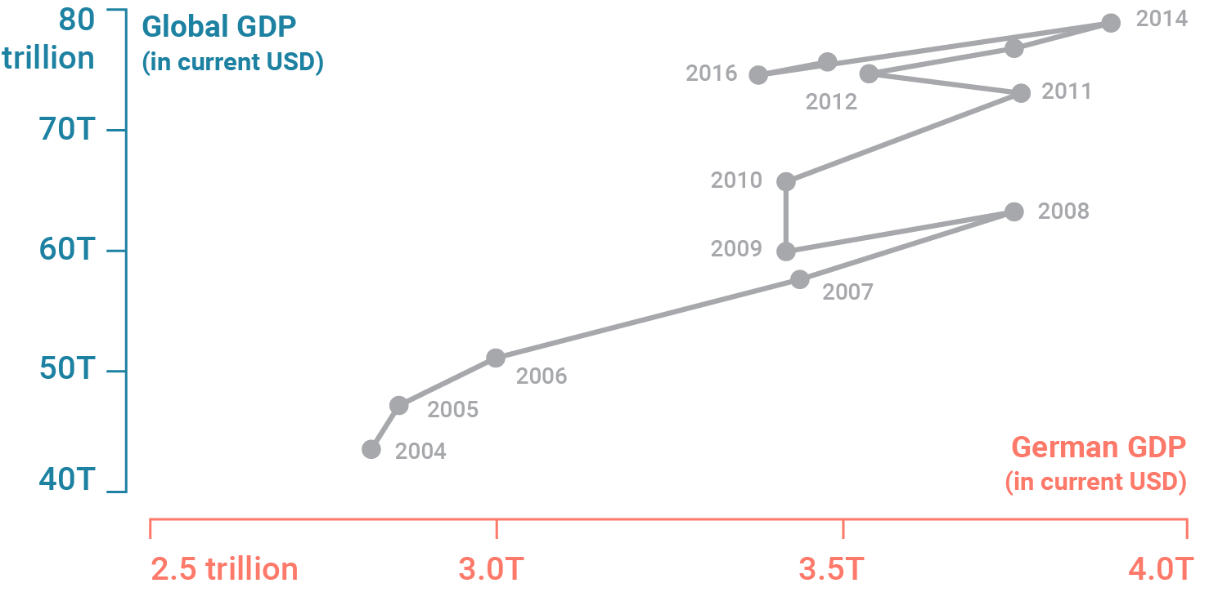
Solution 3. Connected scatter plot
Unintuitive, but fun
Sometimes, overkill
Adapted from https://blog.datawrapper.de/dualaxis/

Slide 29
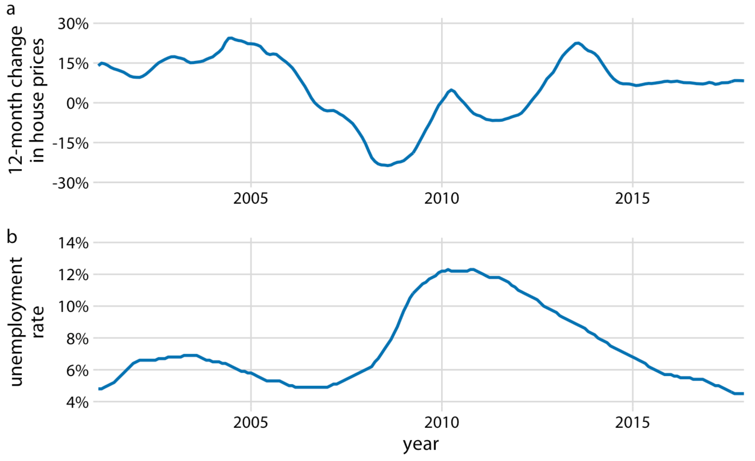
Line graph to show trend of ≥ 2 variables
E.g., consider house prices in relation to unemployment rate
Interested in temporal regions when both variables move in the same or in opposite directions.
Could use a dual-axis chart to show both
Fundamentals of Data Visualization, Wilke, O’Reilly, 1st Ed.
Notes:
In the preceding examples we dealt with time courses of only a single response variable (e.g., preprint submissions per month or oat yield). It is not unusual, however, to have more than one response variable. For example, we may be interested in the change in house prices from the previous 12 months as it relates to the unemployment rate. We may expect that house prices rise when the unemployment rate is low and vice versa.
Given the tools from the preceding subsections, we can visualize such data as two separate line graphs stacked on top of each other (Figure 13.9). This plot directly shows the two variables of interest, and it is straightforward to interpret. However, because the two variables are shown as separate line graphs, drawing comparisons between them can be cumbersome. If we want to identify temporal regions when both variables move in the same or in opposite directions, we need to switch back and forth between the two graphs and compare the relative slopes of the two curves.

Slide 30
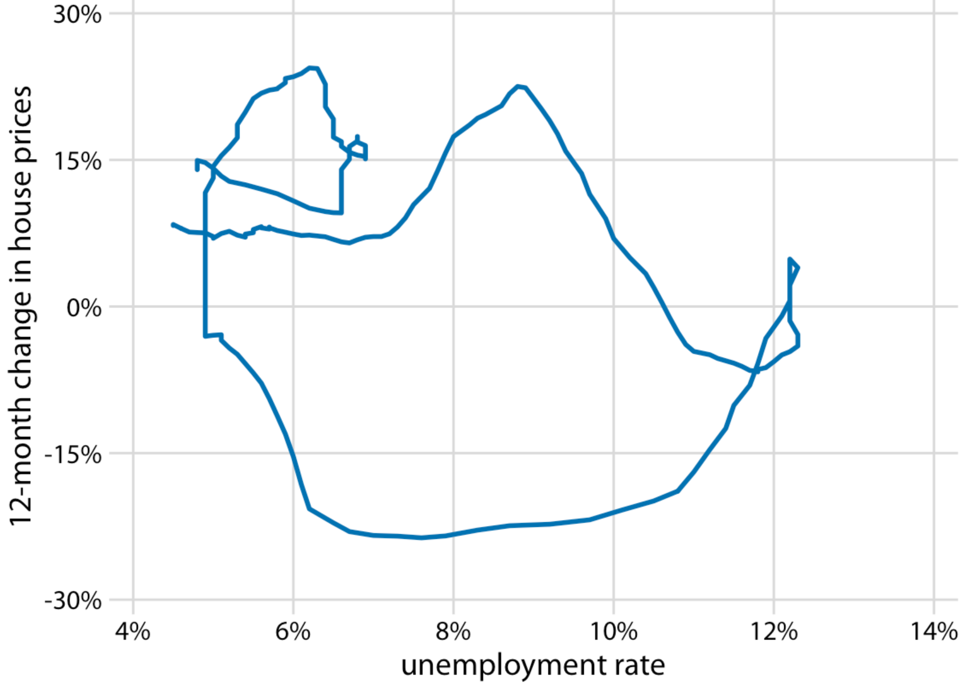
Connected scatter plot to show trend of ≥ 2 variables
Like scatterplots: plotting two variables against each other
Unlike scatterplots: connecting neighboring points from the earliest time point to the latest
Fundamentals of Data Visualization, Wilke, O’Reilly, 1st Ed.
Notes:
As an alternative to showing two separate line graphs, we can plot the two variables against each other, drawing a path that leads from the earliest time point to the latest (Figure 13.10). Such a visualization is called a connected scatter plot, because we are technically making a scatter plot of the two variables against each other and then are connecting neighboring points. Physicists and engineers often call this a phase portrait, because in their disciplines it is comm

Slide 31
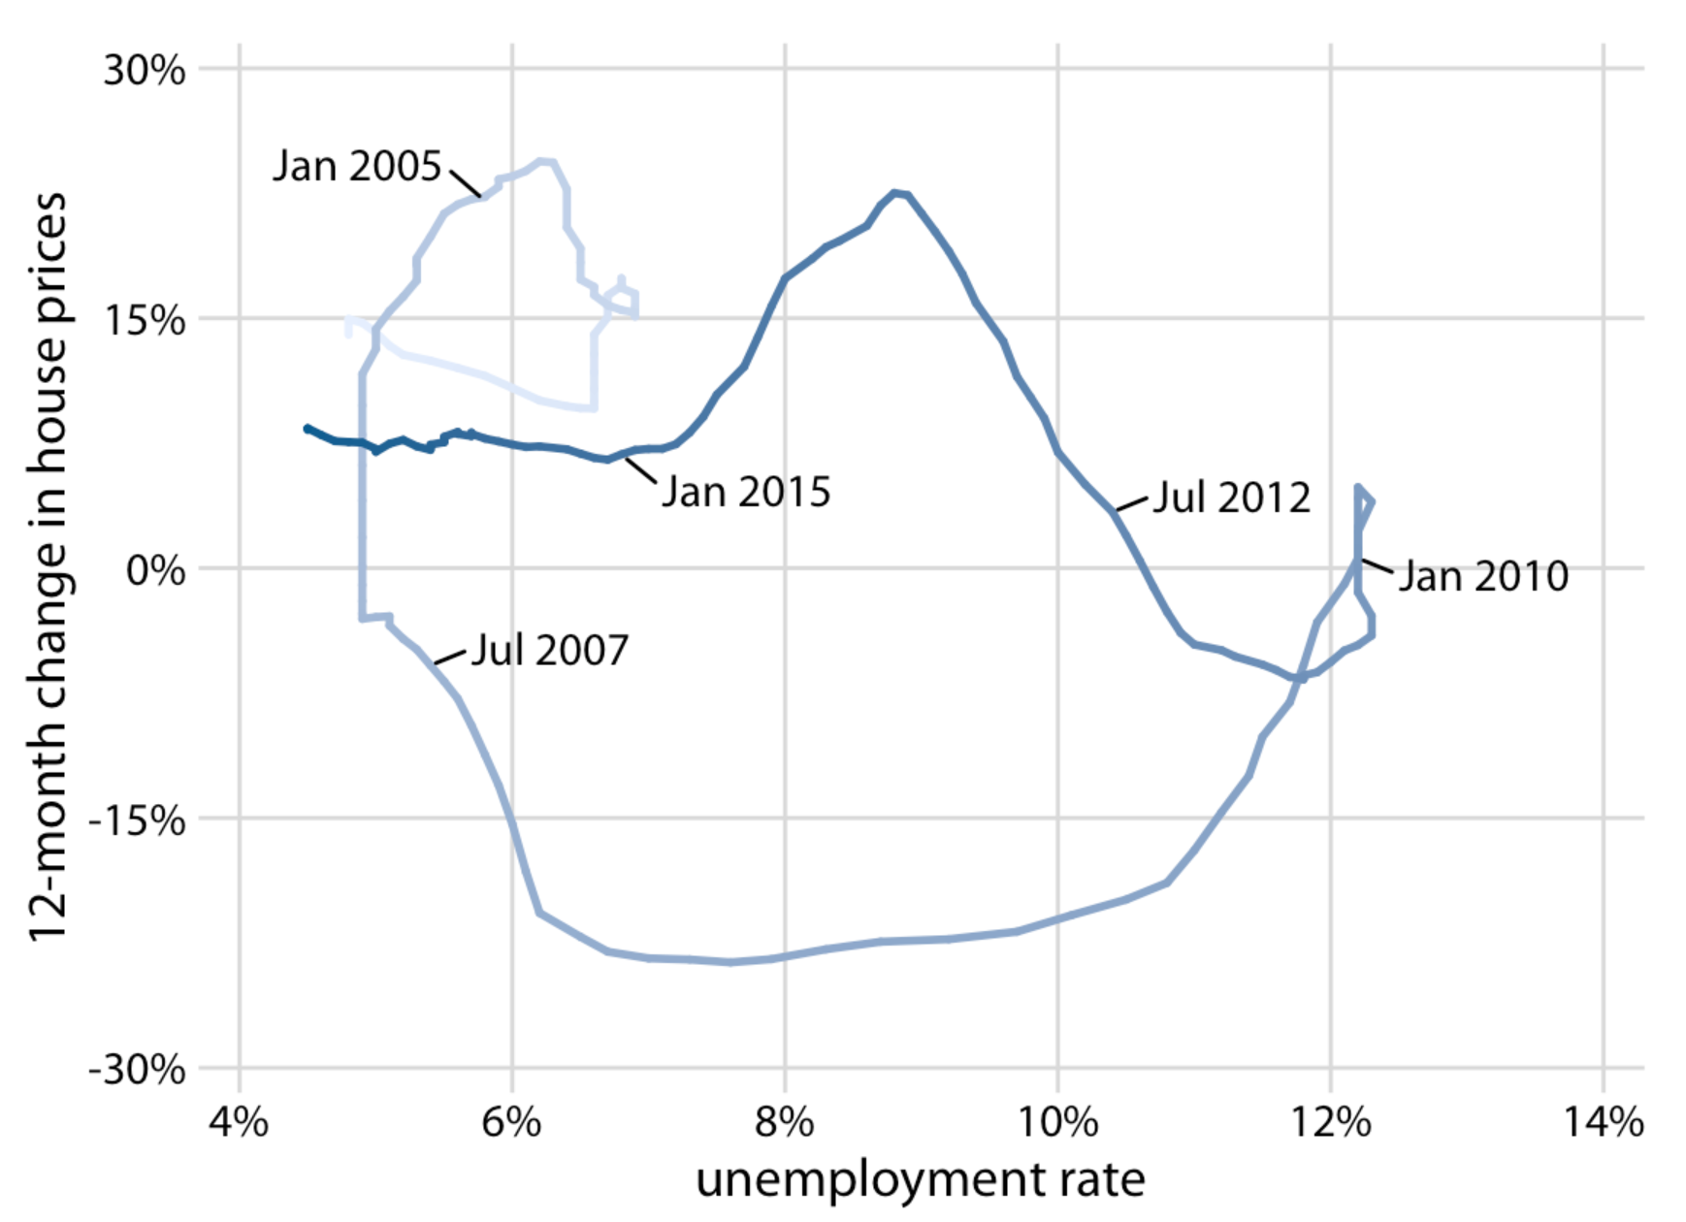
Connected scatter plot to show trend of ≥ 2 variables
Important to indicate both the direction and the temporal scale of the data
E.g., encode time with color gradation or arrows
Fundamentals of Data Visualization, Wilke, O’Reilly, 1st Ed.
Notes:
When drawing a connected scatter plot, it is important that we indicate both the direction and the temporal scale of the data. Without such hints, the plot can turn into meaningless scribble (Figure 13.11). I am using here (in Figure 13.10) a gradual darkening of the color to indicate direction. Alternatively, one could draw arrows along the path.
In a connected scatter plot, lines going in the direction from the lower left to the upper right represent correlated movement between the two variables (as one variable grows, so does the other), and lines going in the perpendicular direction, from the upper left to the lower right, represent anti-correlated movement (as one variable grows, the other shrinks). If the two variables have a somewhat cyclic relationship, we will see circles or spirals in the connected scatter plot. In Figure 13.10, we see one small circle from 2001 through 2005 and one large circle for the remainder of the time course.

Slide 32
Connected scatter plot to show trend of ≥ 2 response variables
Positive/negative correlation -> lines lying in the “northeast” or “southeast” directions
Cyclic relationship → loops
Transition of the center of the circles?
Fundamentals of Data Visualization, Wilke, O’Reilly, 1st Ed.
Notes:
When drawing a connected scatter plot, it is important that we indicate both the direction and the temporal scale of the data. Without such hints, the plot can turn into meaningless scribble (Figure 13.11). I am using here (in Figure 13.10) a gradual darkening of the color to indicate direction. Alternatively, one could draw arrows along the path.
In a connected scatter plot, lines going in the direction from the lower left to the upper right represent correlated movement between the two variables (as one variable grows, so does the other), and lines going in the perpendicular direction, from the upper left to the lower right, represent anti-correlated movement (as one variable grows, the other shrinks). If the two variables have a somewhat cyclic relationship, we will see circles or spirals in the connected scatter plot. In Figure 13.10, we see one small circle from 2001 through 2005 and one large circle for the remainder of the time course.

Slide 33
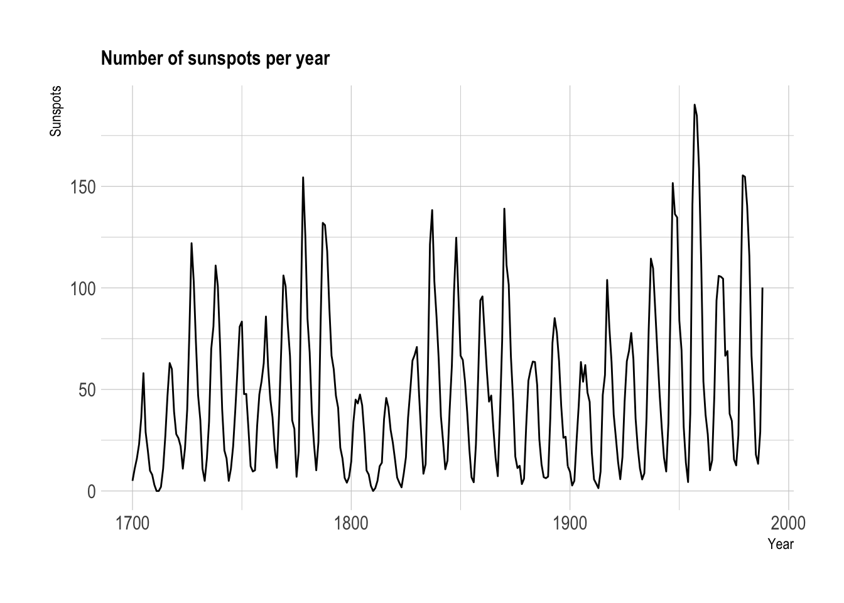
Different aspect ratios show different trends
The sunspot numbers follow a periodic 11-year cycle
Some spikes are higher than others
https://www.data-to-viz.com/caveat/aspect_ratio.html
Notes:
Here is an example with a line plot showing yearly sunspot numbers from 1749 to 1983. (Sunspots are temporary phenomena on the Sun’s photosphere that appear as spots darker than the surrounding areas.).
The solar cycle is quite obvious on this figure. The sunspot numbers follow this periodic 11-year change in the sun’s activity, making the line go up and down quite regularly. It is also clear that some spikes are higher than others, with maximum smoothed sunspot numbers ranging from 50 to 180.
https://www.data-to-viz.com/caveat/aspect_ratio.html

Slide 34
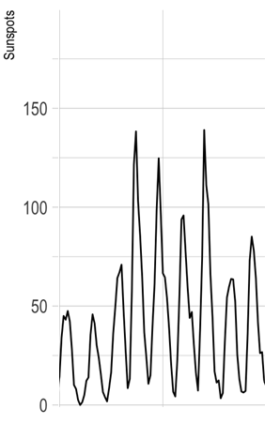
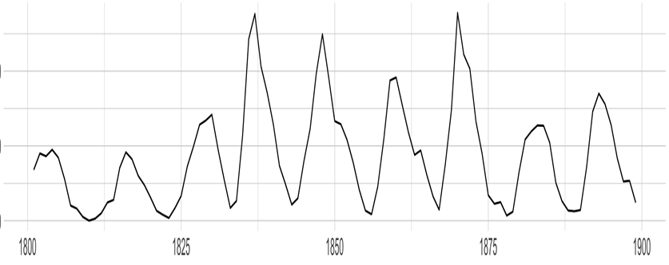
Different aspect ratios show different trends
Aspect ratio: the ratio of the width to the height of a graphic
the sunspot # increases quicker than it decreases in a wider aspect ratio
1800
1900
https://www.data-to-viz.com/caveat/aspect_ratio.html
Notes:
Now let’s change the aspect ratio of this figure, making it wider and less high. To exaggerate the effect, the graphic is zoomed to the 1800 to 1900 period:

Slide 35
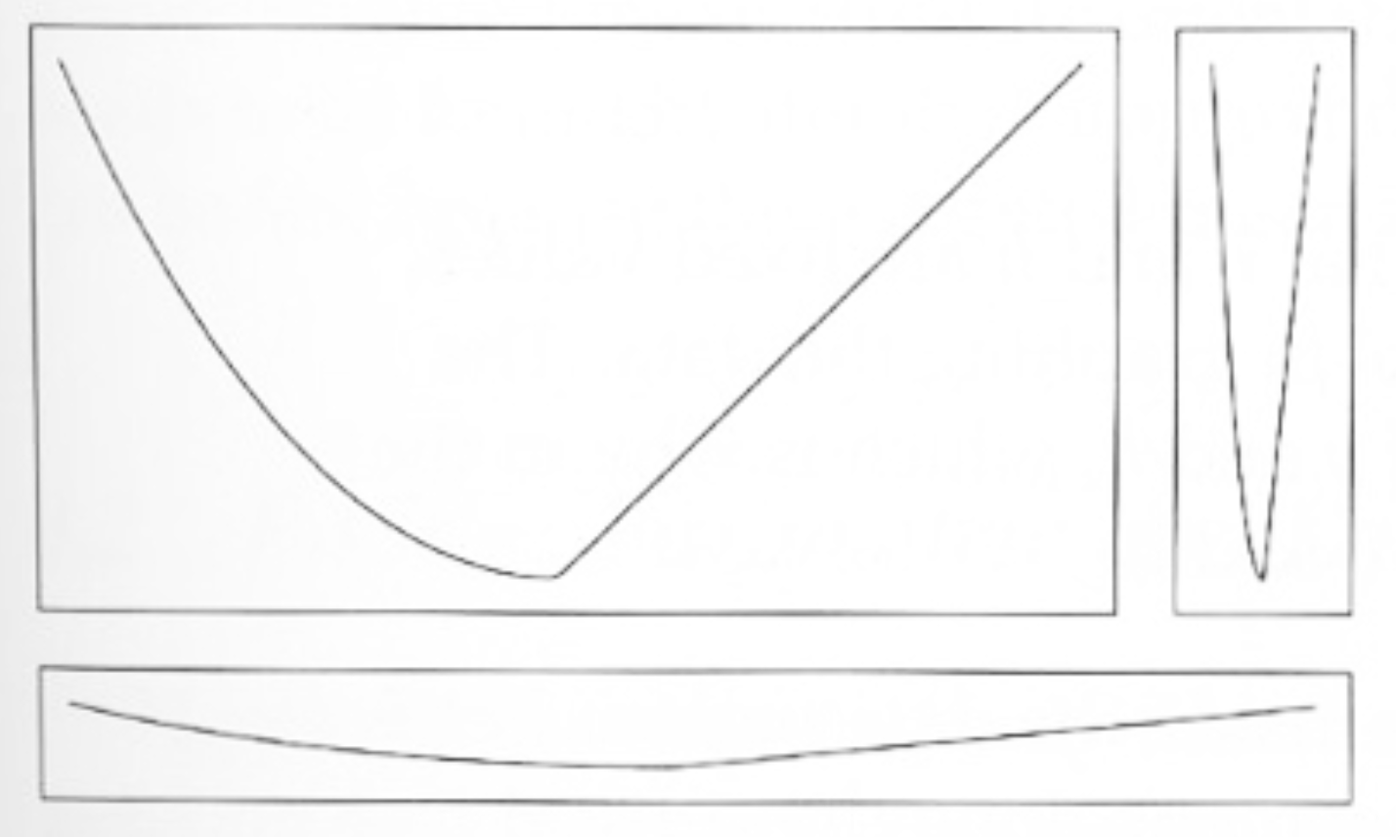
Different aspect ratios show different trends
The signal should be placed in the 2/3rd portion of the y-axis
The pattern of your interest should target a 45° angle (?)
W.S. Cleveland. 1993. Visualizing Data.
Notes:
Here is a figure from W.S. Cleveland explaining that the aspect ratio of a graphic should target a 45 degree angle on this kind of figure. It shows what happens when angles are too big or too small:

Slide 36
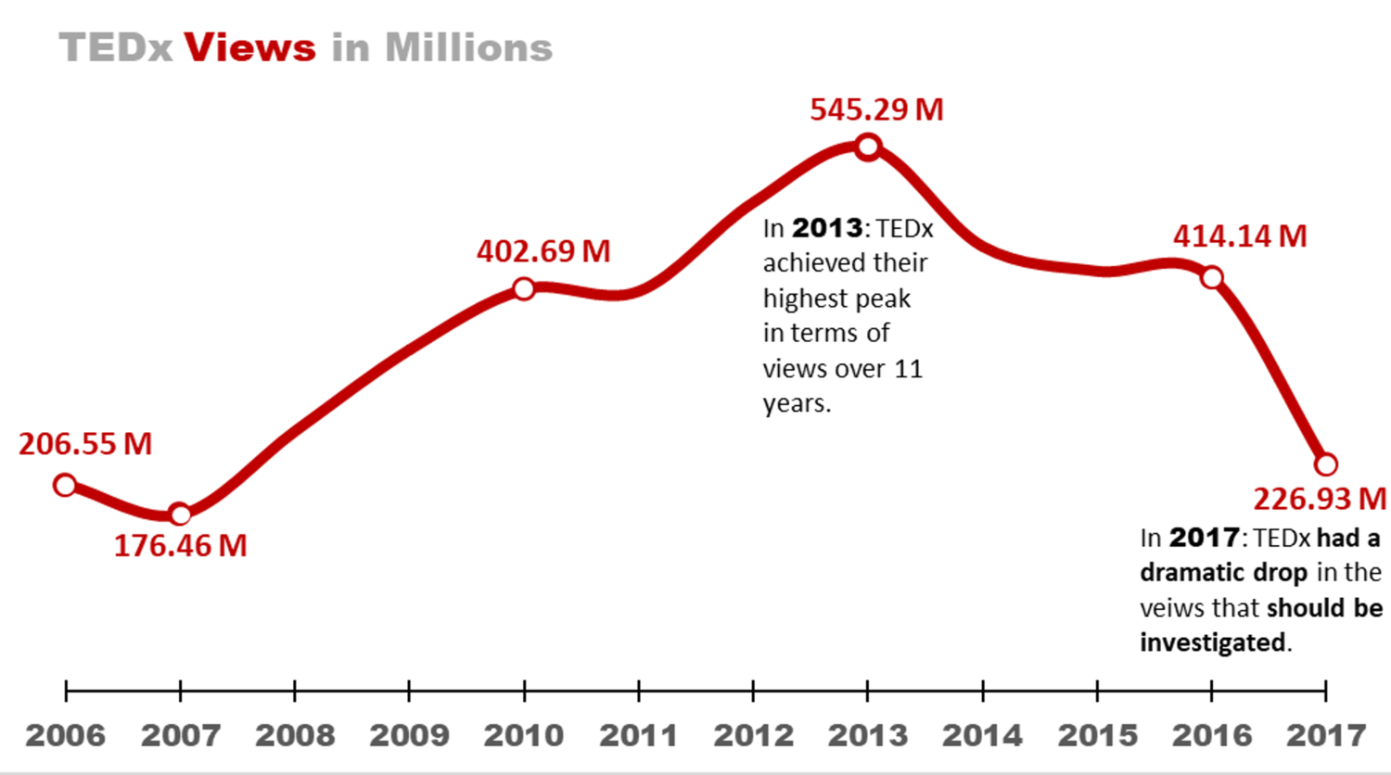
Annotated line graph
Due to the simplicity, possible to annotate additional information
Critical to determine the appropriate amount of information.
http://www.storytellingwithdata.com/blog/2018/1/22/88-annotated-line-graphs

Slide 37
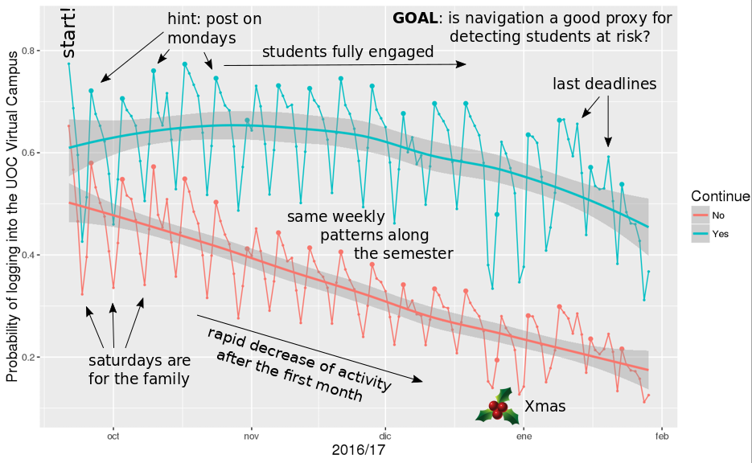
Line graph with too much annotation
Each additional label might not seem like “too much”
Eventually you can end up with too much information
→ Critical to determine the appropriate amount of info.
http://www.storytellingwithdata.com/blog/2018/1/22/88-annotated-line-graphs

Slide 38
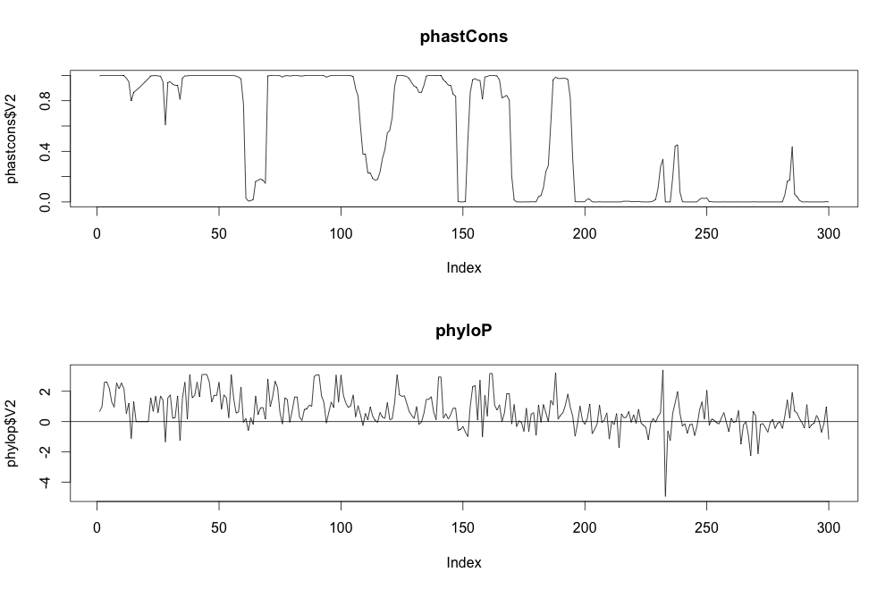
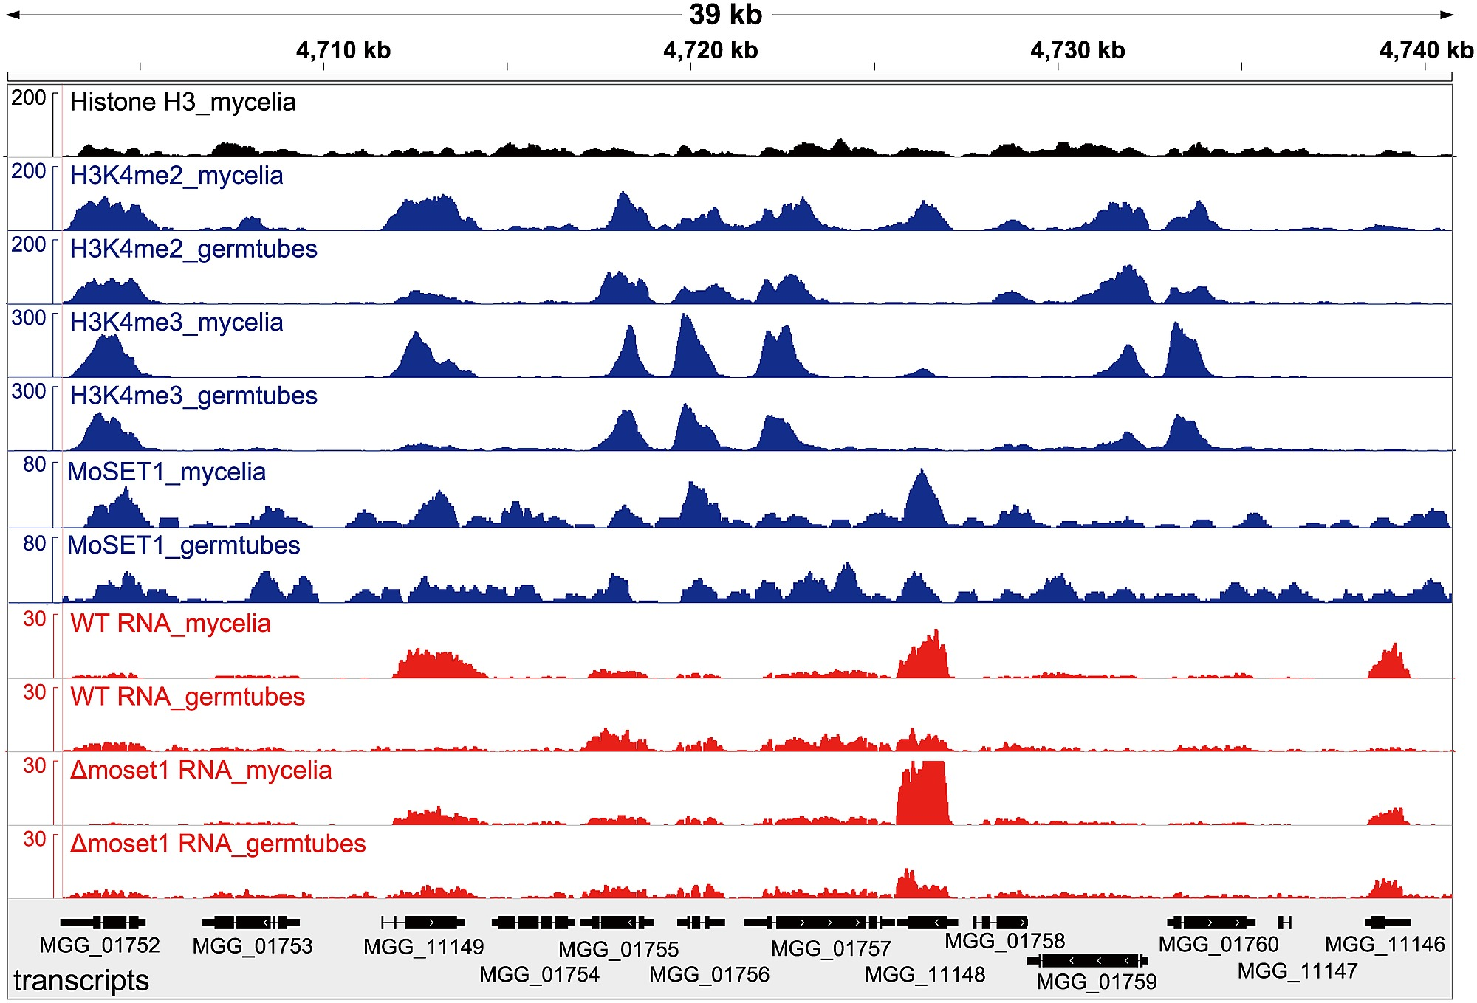

Complex biological signals in line plots
Genetic/epigenetic signal from sequencing data
Conservation signal on genomics data
https://davetang.org/muse/2014/08/28/finding-sequence-conservation/
Dynamic changes across the whole genome (e. g., 6.4 billion BP for human)

Slide 39
Shaded line plots for each case
To discuss in detail when covering Genome Browser
Pham et al. PLOS Genetics. 2015

Slide 40
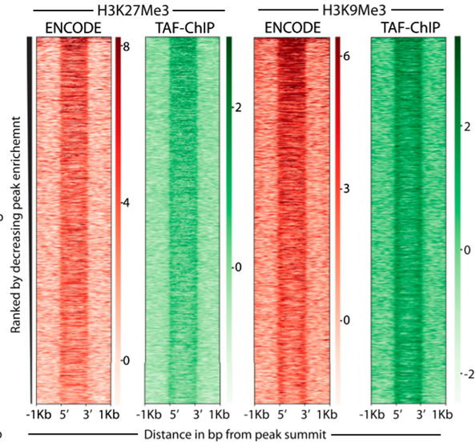
Heatmaps to show many signals
Multiple
regions
Akhtar et al. Life Science Alliance, 2019

Slide 41
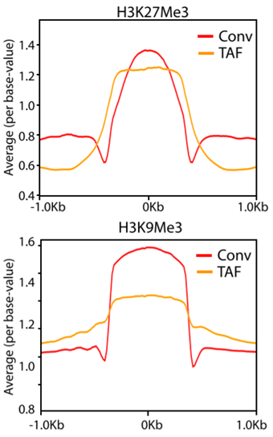
Lines plots as summary of MANY signals
Akhtar et al. Life Science Alliance, 2019

Slide 42
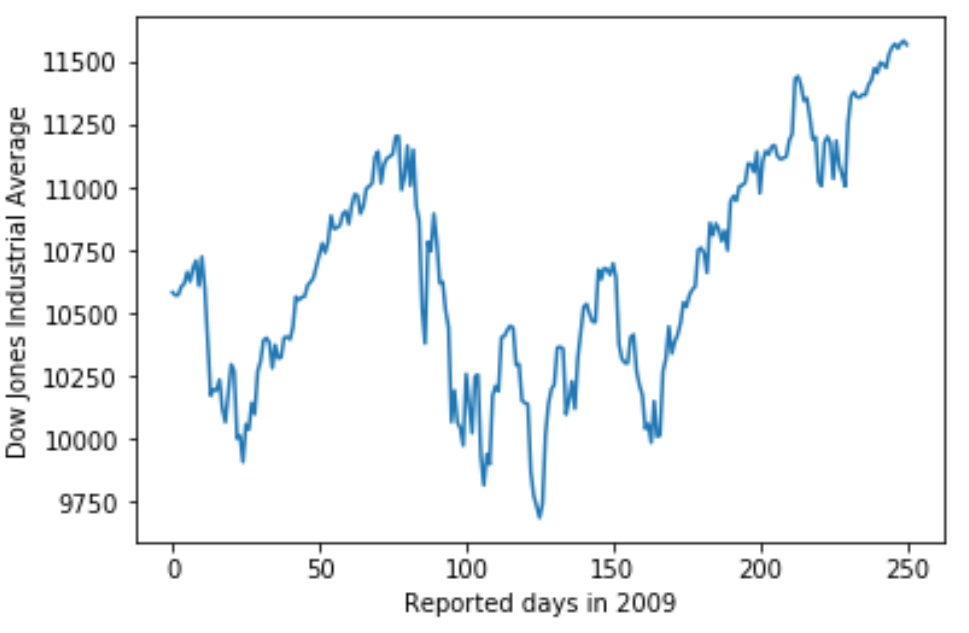
Sliding window to show trends in complex signal shape
Notes:
Let us consider a time series of the Dow Jones Industrial Average (Dow Jones for short), a stock-market index representing the price of 30 large, publicly owned U.S. companies. Specifically, we will look at the year 2009, right after the 2008 crash (Figure 14.1). During the tail end of the crash, in the first three months of the year 2009, the market lost over 2400 points (~27%). Then it slowly recovered for the remainder of the year. How can we visualize these longer-term trends while de-emphasizing the less important short-term fluctuations?

Slide 43
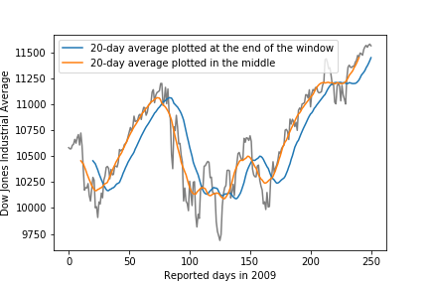
Sliding window to show trends in complex signal shape
To capture key patterns while removing irrelevant minor detail or noise, one can calculate moving averages
Depending on where the window is “centered”/how it’s smoothed, the smoothing curve may generate a lag
Notes:
In statistical terms, we are looking for a way to smooth the stock-market time series. The act of smoothing produces a function that captures key patterns in the data while removing irrelevant minor detail or noise. Financial analysts usually smooth stock-market data by calculating moving averages. To generate a moving average, we take a time window, say the first 20 days in the time series, calculate the average price over these 20 days, then move the time window by one day, so it now spans the 2nd to 21st day, calculate the average over these 20 days, move the time window again, and so on. The result is a new time series consisting of a sequence of averaged prices.
To plot this sequence of moving averages, we need to decide which specific time point to associate with the average for each time window. Financial analysts often plot each average at the end of its respective time window. This choice results in curves that lag the original data (Figure 14.2a), with more severe lags corresponding to larger averaging time windows. Statisticians, on the other hand, plot the average at the center of the time window, which results in a curve that overlays perfectly on the original data (Figure 14.2b).

Slide 44
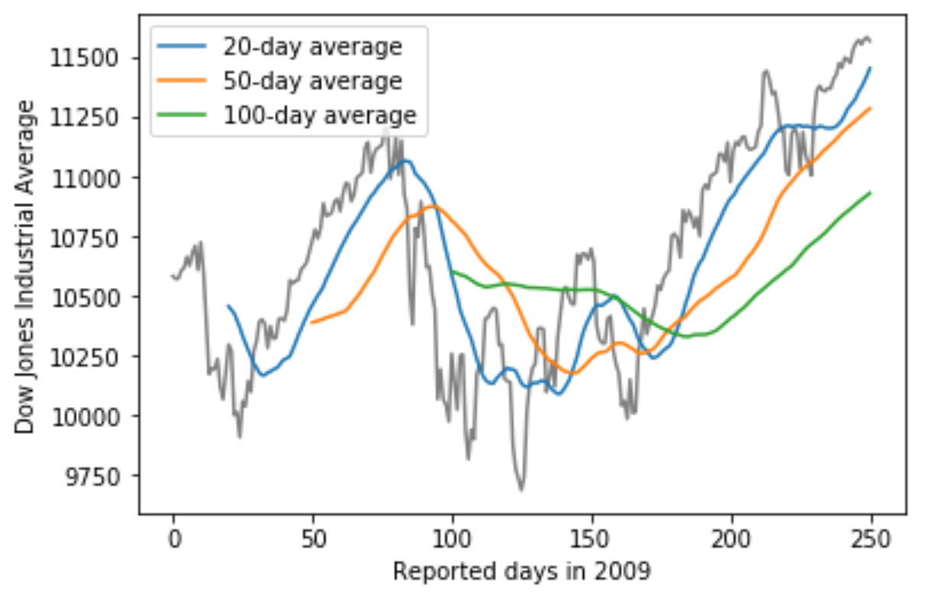
Sliding window to show trends in complex signal shape
With short-range window, small smoothing effect
With wide-range window, can focus on a broader pattern
As with bin width and band width (for histograms/density plots), one can manually check the patterns and determine the range
Notes:
Regardless of whether we plot the smoothed time series with or without lag, we can see that the length of the time window over which we average sets the scale of the fluctuations that remain visible in the smoothed curve. The 20-day moving average only removes small, short-term spikes but otherwise follows the daily data closely. The 100-day moving average, on the other hand, removes even fairly substantial drops or spikes that play out over a time span of multiple weeks. For example, the massive drop to below 7000 points in the first quarter of 2009 is not visible in the 100-day moving average, which replaces it with a gentle curve that doesn’t dip much below 8000 points (Figure 14.2). Similarly, the drop around July 2009 is completely invisible in the 100-day moving average.

Slide 45
Sliding window to show trends in complex signal shape
Pros
Simple to implement and interpret
Often used to do AI on signal data
Cons
Shorter than the original curve. The more smoothing, the shorter the curve
How to interpret with lags?
Still not that smooth?
Notes:
The moving average is the most simplistic approach to smoothing, and it has some obvious limitations. First, it results in a smoothed curve that is shorter than the original curve (Figure 14.2). Parts are missing at either the beginning or the end or both. And the more the time series is smoothed (i.e., the larger the averaging window), the shorter the smoothed curve. Second, even with a large averaging window, a moving average is not necessarily that smooth. It may exhibit small bumps and wiggles even though larger-scale smoothing has been achieved (Figure 14.2). These wiggles are caused by individual data points that enter or exit the averaging window. Since all data points in the window are weighted equally, individual data points at the window boundaries can have visible impact on the average.

Slide 46
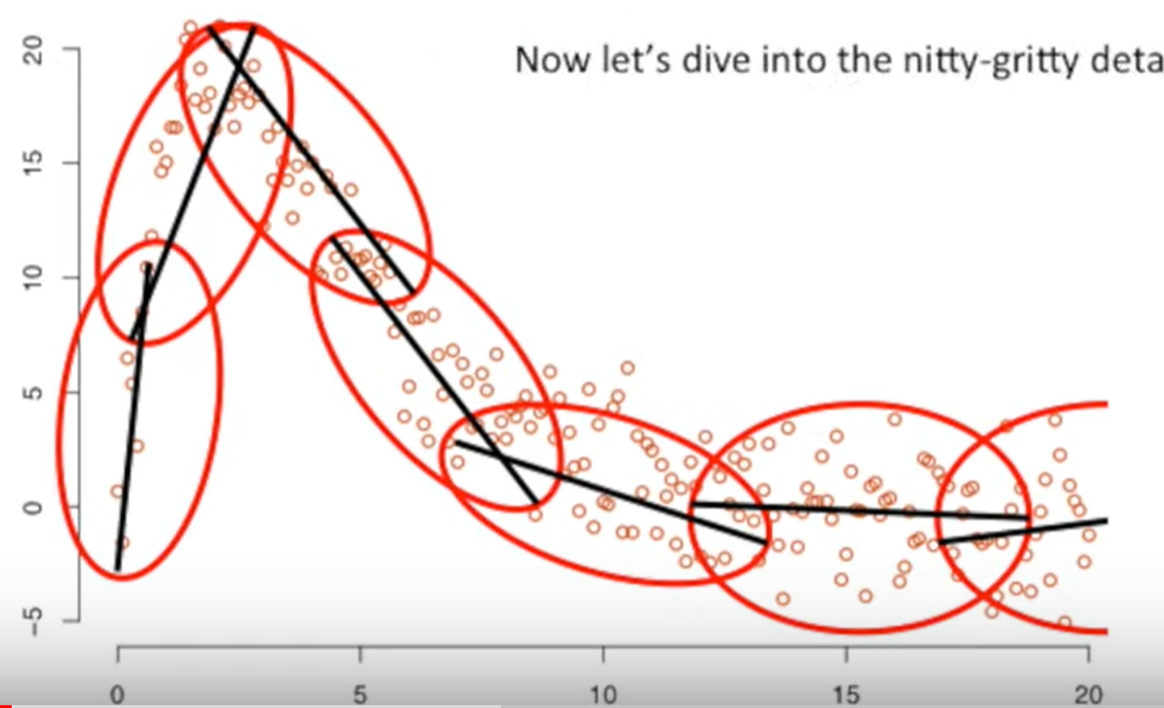
Locally Weighted Scatterplot Smoothing (LOWESS)
Like moving window, use a sliding window to divide the data into smaller chunks
Unlike a moving window, it fits a polynomial regression in each window, where center points in the window are weighted more heavily
Adapted from https://www.youtube.com/watch?v=Vf7oJ6z2LCc
Notes:
Statisticians have developed numerous approaches to smoothing that alleviate the downsides of moving averages. These approaches are much more complex and computationally costly, but they are readily available in modern statistical computing environments. One widely used method is LOESS (locally estimated scatterplot smoothing, W. S. Cleveland (1979)), which fits low-degree polynomials to subsets of the data. Importantly, the points in the center of each subset are weighted more heavily than points at the boundaries, and this weighting scheme yields a much smoother result than we get from a weighted average (Figure 14.3).

Slide 47
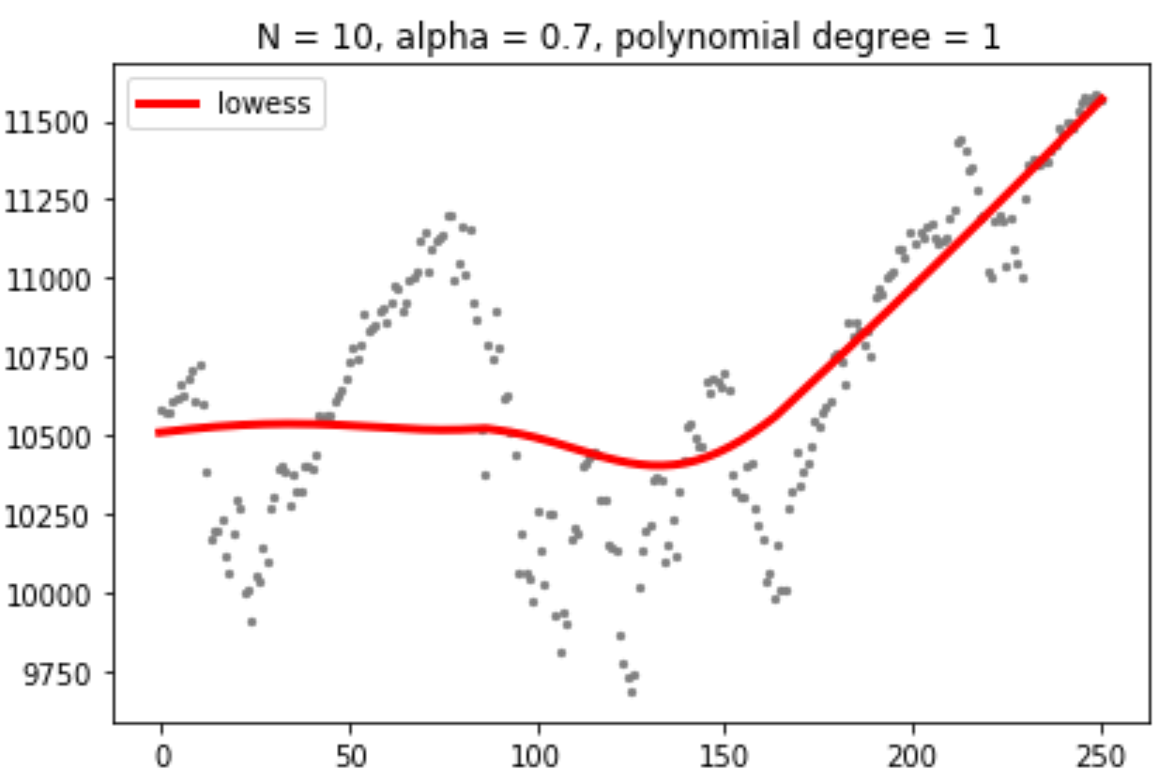
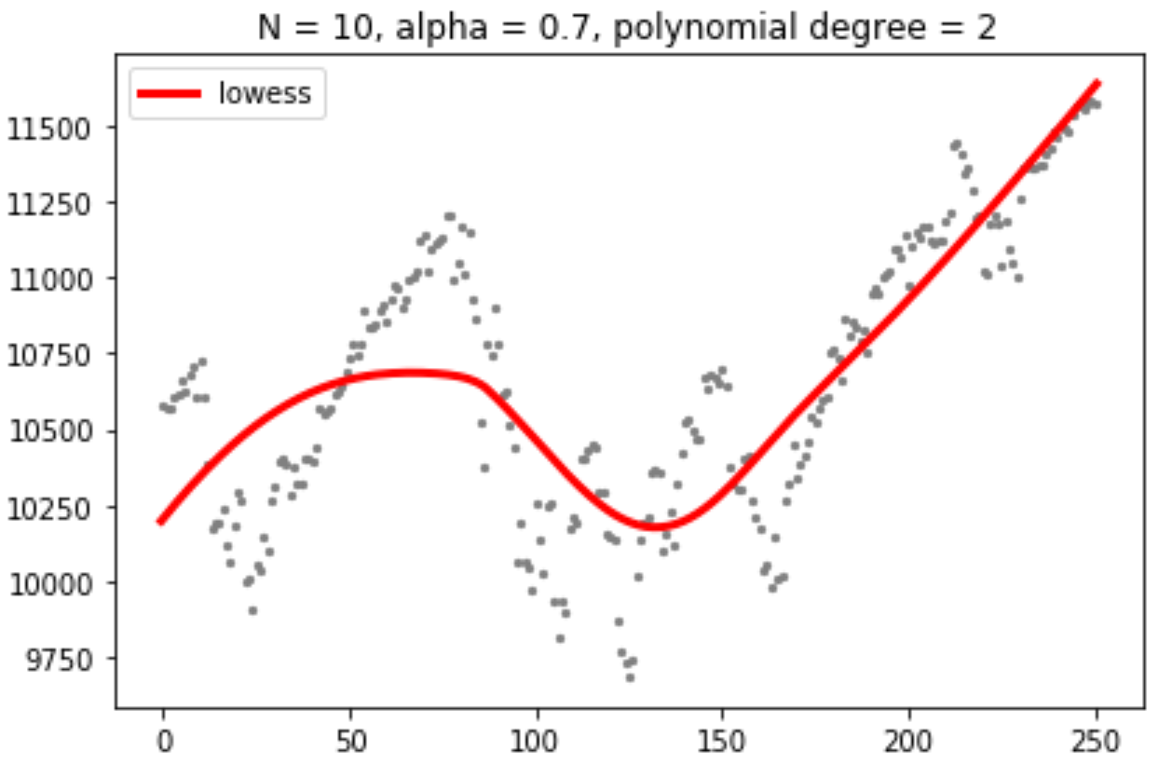
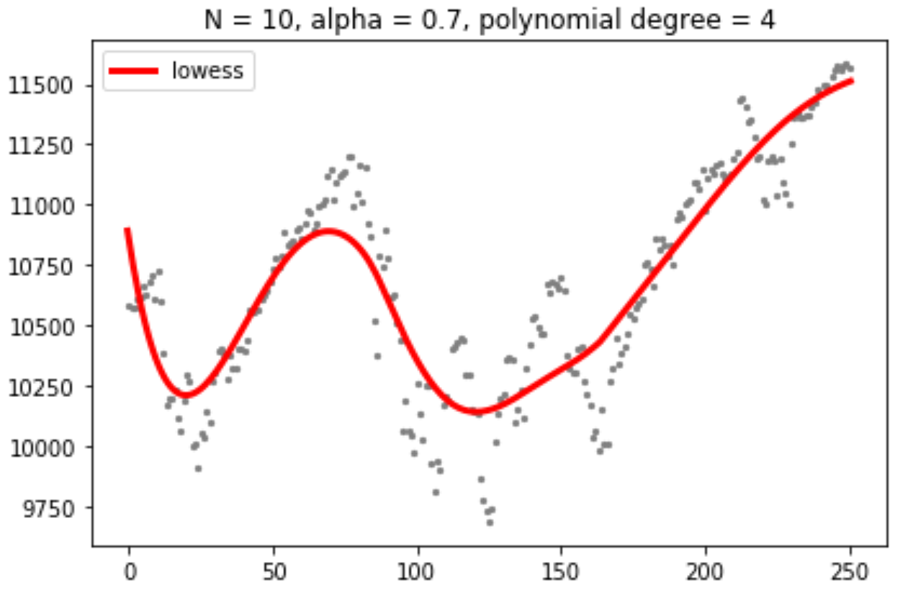
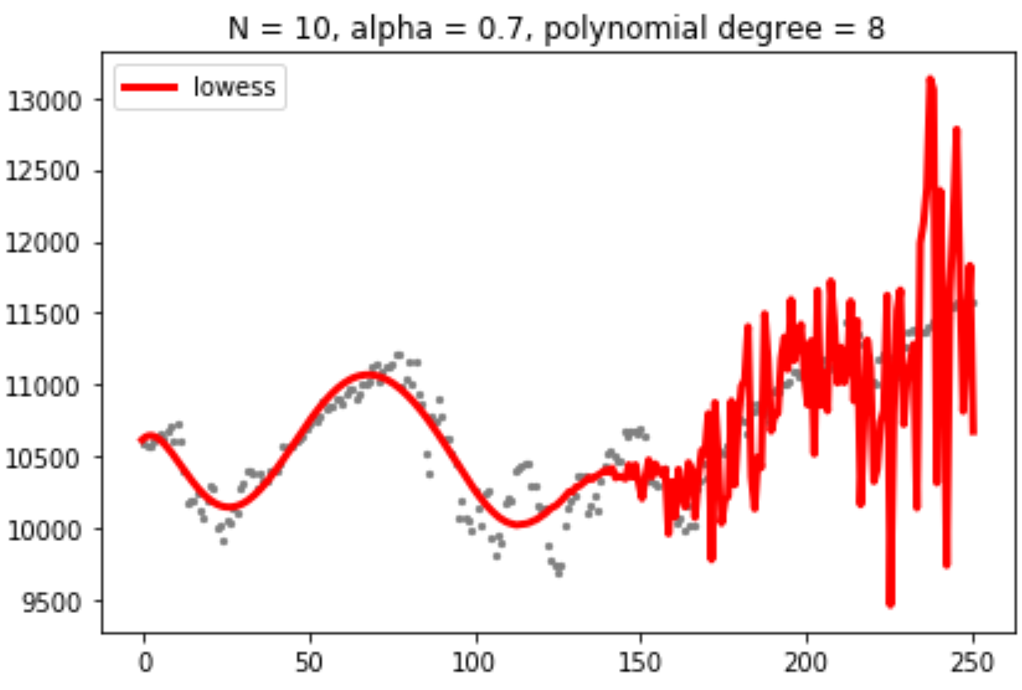
LOWESS with different fitting parameters
Polynomial degree matters!
Implications for prediction?
Notes:
The LOESS curve shown here looks similar to the 100-day average, but this similarity should not be overinterpreted. The smoothness of a LOESS curve can be tuned by adjusting a parameter, and different parameter choices would have produced LOESS curves looking more like the 20-day or 50-day average.

Slide 48
High polynomial degree may lead to overfitting in LOESS
Overfitting fits the model to the non-signal parts of data that the resulting model
Does not represent the underlying signal
Cannot predict future observations reliably
However, LOESS is not for prediction
Notes:
overfitting is "the production of an analysis that corresponds too closely or exactly to a particular set of data, and may therefore fail to fit additional data or predict future observations reliably".^{[1]} An overfitted model is a statistical model that contains more parameters than can be justified by the data.^{[2]} The essence of overfitting is to have unknowingly extracted some of the residual variation (i.e. the noise) as if that variation represented underlying model structure.^{[3]:45}
Underfitting occurs when a statistical model cannot adequately capture the underlying structure of the data. An underfitted model is a model where some parameters or terms that would appear in a correctly specified model are missing.^{[2]} Underfitting would occur, for example, when fitting a linear model to non-linear data. Such a model will tend to have poor predictive performance.
Overfitting and underfitting can occur in machine learning, in particular. In machine learning, the phenomena are sometimes called "overtraining" and "undertraining".

Slide 49
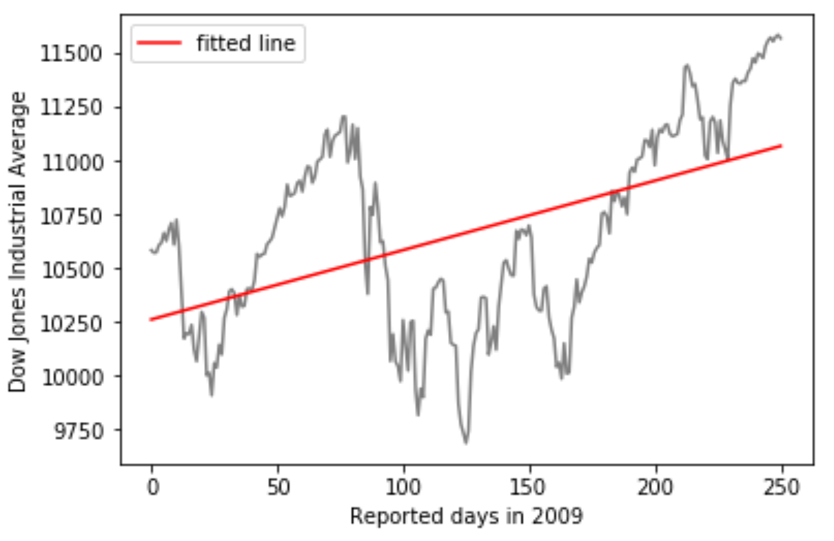
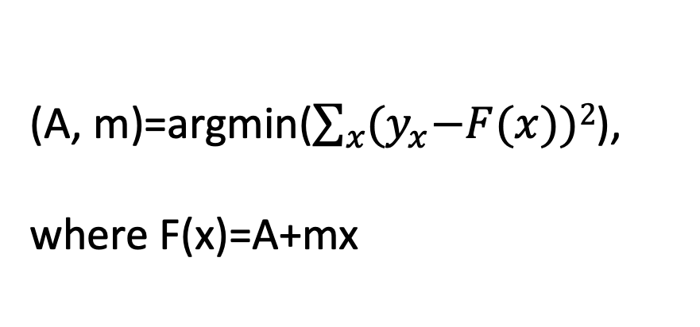
Linear least square regression to predict based on linear trend
(A, m)=argmin($\sum_{x}{{(y}_{x}−F(x))2}$),
where F(x)=A+mx
Notes:
A functional form that is applicable in many different contexts is the simple straight line, y=A+mxy=A+mx. Approximately linear relationships between two variables are surprisingly common in real-world datasets.
In this example, x is reported days in 2009 and y is Dow Jones index.
However, Dow Jones index apparently does not display non-linear relationship.

Slide 50



Quadratic least square regression to predict based on nonlinear trend
(A, m)=argmin($\sum_{x}{{(y}_{x}−F(x))2}$),
, where F(x)
Notes:
When the data display a non-linear relationship, we need to guess what an appropriate functional form might be.

Slide 51

Systematic ways to overcome the overfit
The higher the degree is (the more variables it has), the better it fits to the data
What is the right degree (or complexity or the number of variables) of the model for the data?
Akaike Information Criteria (AIC), Bayesian Information Criteria (BIC), or variable selection (e. g., via penalization)
https://www.quora.com/What-are-the-key-trade-offs-between-overfitting-and-underfitting
Notes:
overfitting is "the production of an analysis that corresponds too closely or exactly to a particular set of data, and may therefore fail to fit additional data or predict future observations reliably".^{[1]} An overfitted model is a statistical model that contains more parameters than can be justified by the data.^{[2]} The essence of overfitting is to have unknowingly extracted some of the residual variation (i.e. the noise) as if that variation represented underlying model structure.^{[3]:45}
Underfitting occurs when a statistical model cannot adequately capture the underlying structure of the data. An underfitted model is a model where some parameters or terms that would appear in a correctly specified model are missing.^{[2]} Underfitting would occur, for example, when fitting a linear model to non-linear data. Such a model will tend to have poor predictive performance.
Overfitting and underfitting can occur in machine learning, in particular. In machine learning, the phenomena are sometimes called "overtraining" and "undertraining".

Slide 52
Transforming axes may help explain the underlying relationship
Δy(t) ∝ y(t-1)
E. g., the increase in submissions in a month
Monthly submissions to the preprint server bioRxiv.
Fundamentals of Data Visualization, Wilke, O’Reilly, 1st Ed.
Notes:
When the data display a non-linear relationship, we need to guess what an appropriate functional form might be. In this case, we can assess the accuracy of our guess by transforming the axes in such a way that a linear relationship emerges. To demonstrate this principle, let’s return to the monthly submissions to the preprint server bioRxiv, discussed in Chapter 12. If the increase in submissions in each month is proportional to the number of submissions in the previous month, i.e., if submissions grow by a fixed percentage each month, then the resulting curve is exponential
In Figure 14.9, in addition to the actual submission counts, I am also showing the exponential fit from Figure 14.8 and a linear fit to the log-transformed data. These two fits are similar but not identical. In particular, the slope of the dashed line seems somewhat off. The line systematically falls above the individual data points for half the time series. This is a common problem with exponential fits: The square deviations from the data points to the fitted curve are so much larger for the largest data values than for the smallest data values that the deviations of the smallest data values contribute little to the overall sum squares that the fit minimizes. As a result, the fitted line systematically overshoots or undershoots the smallest data values. For this reason, I generally advise to avoid exponential fits and instead use linear fits on log-transformed data.
A plot such as Figure 14.9 is commonly referred to as log–linear, since the y axis is logarithmic and the x axis is linear. Other plots we may encounter include log–log, where both the y and the x axis are logarithmic, or linear–log, where y is linear and x is logarithmic. In a log–log plot, power laws of the form y∼xαy∼xα appear as straight lines (see Figure 8.7 for an example), and in a linear–log plot, logarithmic relationships of the form y∼log(x)y∼log⁡(x) appear as a straight lines. Other functional forms can be turned into linear relationships with more specialized coordinate transformations, but these three (log–linear, log–log, linear–log) cover a wide range of real-world applications.

Slide 53
Transforming axes may help explain the underlying relationship
Monthly submissions to the preprint server bioRxiv.
Δy(t) ∝ y(t-1)
E. g., the increase in submissions in a month
Exponential growth function grows at a constant percent growth rate
y=exp(A+mx)
Fundamentals of Data Visualization, Wilke, O’Reilly, 1st Ed.
Notes:
When the data display a non-linear relationship, we need to guess what an appropriate functional form might be. In this case, we can assess the accuracy of our guess by transforming the axes in such a way that a linear relationship emerges. To demonstrate this principle, let’s return to the monthly submissions to the preprint server bioRxiv, discussed in Chapter 12. If the increase in submissions in each month is proportional to the number of submissions in the previous month, i.e., if submissions grow by a fixed percentage each month, then the resulting curve is exponential
In Figure 14.9, in addition to the actual submission counts, I am also showing the exponential fit from Figure 14.8 and a linear fit to the log-transformed data. These two fits are similar but not identical. In particular, the slope of the dashed line seems somewhat off. The line systematically falls above the individual data points for half the time series. This is a common problem with exponential fits: The square deviations from the data points to the fitted curve are so much larger for the largest data values than for the smallest data values that the deviations of the smallest data values contribute little to the overall sum squares that the fit minimizes. As a result, the fitted line systematically overshoots or undershoots the smallest data values. For this reason, I generally advise to avoid exponential fits and instead use linear fits on log-transformed data.
A plot such as Figure 14.9 is commonly referred to as log–linear, since the y axis is logarithmic and the x axis is linear. Other plots we may encounter include log–log, where both the y and the x axis are logarithmic, or linear–log, where y is linear and x is logarithmic. In a log–log plot, power laws of the form y∼xαy∼xα appear as straight lines (see Figure 8.7 for an example), and in a linear–log plot, logarithmic relationships of the form y∼log(x)y∼log⁡(x) appear as a straight lines. Other functional forms can be turned into linear relationships with more specialized coordinate transformations, but these three (log–linear, log–log, linear–log) cover a wide range of real-world applications.

Slide 54

How do I select a distribution to try fitting
Log-linear
log(y)=A+mx
log-log
y∼x^{α}
power laws
Linear-log
y∼log(x)
cover a wide range of real-world applications
Monthly submissions to the preprint server bioRxiv.
Fundamentals of Data Visualization, Wilke, O’Reilly, 1st Ed.
Notes:
This assumption seems to be met for the bioRxiv data, because a curve with exponential form, y=Aexp(mx)y=Aexp⁡(mx), fits the bioRxiv submission data well (Figure 14.8).
A plot such as Figure 14.9 is commonly referred to as log–linear, since the y axis is logarithmic and the x axis is linear. Other plots we may encounter include log–log, where both the y and the x axis are logarithmic, or linear–log, where y is linear and x is logarithmic. In a log–log plot, power laws of the form y∼xαy∼xα appear as straight lines (see Figure 8.7 for an example), and in a linear–log plot, logarithmic relationships of the form y∼log(x)y∼log⁡(x) appear as a straight lines. Other functional forms can be turned into linear relationships with more specialized coordinate transformations, but these three (log–linear, log–log, linear–log) cover a wide range of real-world applications.

Slide 55

Detrending to catch signals beyond the “first” trend
Freddie Mac House Price Index
House Price = annual growth + house bubbles
4.7% annual price increase with two bubbles in California
2.8% in the other states
Fundamentals of Data Visualization, Wilke, O’Reilly, 1st Ed.
Notes:
For any time series with a prominent long-term trend, it may be useful to remove this trend to specifically highlight any notable deviations. This technique is called detrending, and I will demonstrate it here with house prices. In the U.S., the mortgage lender Freddie Mac publishes a monthly index, called the Freddie Mac House Price Index, that tracks the change in house prices over time. The index attempts to capture the state of the entire house market in a given region, such that an increase in the index by, for example, 10% can be interpreted as an average house price increase of 10% in the respective market. The index is arbitrarily set to a value of 100 in December 2000.
Over long periods of time, house prices tend to display consistent annual growth, approximately in line with inflation. However, overlaid on top of this trend are housing bubbles that lead to severe boom and bust cycles. Figure 14.10 shows the actual house price index and its long-term trend for four select U.S. states. We see that between 1980 and 2017, California underwent two bubbles, one in 1990 and one in the mid-2000s. During the same period, Nevada experienced only one bubble, in the mid-2000s, and house prices in Texas and West Virginia closely followed their long-term trends the entire time. Because house prices tend to grow in percent increments, i.e., exponentially, I have chosen a logarithmic y axis in Figure 14.10. The straight lines correspond to a 4.7% annual price increase in California and a 2.8% annual price increase each in Nevada, Texas, and West Virginia.

Slide 56

Detrending signals for patterns beyond trend
Detrended Freddie Mac House Price Index
House bubbles = house price - annual growth
A way to check patterns beyond a prominent trend
Fundamentals of Data Visualization, Wilke, O’Reilly, 1st Ed.
Notes:
We detrend housing prices by dividing the actual price index at each time point by the respective value in the long-term trend. Visually, this division will look like we are subtracting the gray lines from the blue lines in Figure 14.10, because a division of the untransformed values is equivalent to a subtraction of the log-transformed values. The resulting detrended house prices show the housing bubbles more clearly (Figure 14.11), as the detrending emphasizes the unexpected movements in a time series. For example, in the original time series, the decline in home prices in California from 1990 to about 1998 looks modest (Figure 14.10). However, during that same time period, on the basis of the long-term trend we would have expected prices to rise. Relative to the expected rise the drop in prices was substantial, amounting to 25% at the lowest point (Figure 14.11).

Slide 57

Detrending time-series data into multiple factors
Monthly observations of airline passengers
A time series consists of
Long-term,
Cyclical variations of various intervals
Etc (random noise+unique external events)
https://machinelearningmastery.com/decompose-time-series-data-trend-seasonality/
Notes:
Beyond simple detrending, we can also separate a time series into multiple distinct components, such that their sum recovers the original time series. In general, in addition to a long-term trend, there are three distinct components that may shape a time series. First, there is random noise, which causes small, erratic movements up and down. This noise is visible in all the time series shown in this chapter, but maybe the most clearly in Figure 14.9. Second, there can be unique external events that leave their mark in the time series, such as the distinct housing bubbles seen in Figure 14.10. Third, there can be cyclical variations. For example, outside temperatures show daily cyclical variations. The highest temperatures are reached in the early afternoon and the lowest temperatures in the early morning. Outside temperatures also show yearly cyclical variations. They tend to rise in the spring, reach their maximum in the summer, and then decline in fall and reach their minimum in the winter (Figure 3.2).
To demonstrate the concept of distinct time-series components, I will here decompose the Keeling curve, which shows changes in CO₂ abundance over time (Figure 14.12). CO₂ is measured in parts per million (ppm). We see a long-term increase in CO₂ abundance that is slightly faster than linear, from below 325 ppm in the 1960s to above 400 in the second decade of the 21st century (Figure 14.12). CO₂ abundance also fluctuates anually, following a consistent up-and-down pattern overlaid on top of the overall increase. The annual fluctuation are driven by plant growth in the northern hemisphere. Plants consume CO₂ during photosynthesis. Because most of the globe’s land masses are located in the northern hemisphere, and plant growth is most active in the spring and summer, we see an annual global decline in atmospheric CO₂ that coincides with the summer months in the northern hemisphere.

Slide 58


Detrending time-series data into multiple factors
Monthly observations of airline passengers
A time series consists of
Long-term,
Cyclical variations of various intervals
Methods available. E. g.,in python
https://machinelearningmastery.com/decompose-time-series-data-trend-seasonality/
Notes:
To demonstrate the concept of distinct time-series components, I will here decompose the Keeling curve, which shows changes in CO₂ abundance over time (Figure 14.12). CO₂ is measured in parts per million (ppm). We see a long-term increase in CO₂ abundance that is slightly faster than linear, from below 325 ppm in the 1960s to above 400 in the second decade of the 21st century (Figure 14.12). CO₂ abundance also fluctuates anually, following a consistent up-and-down pattern overlaid on top of the overall increase. The annual fluctuation are driven by plant growth in the northern hemisphere. Plants consume CO₂ during photosynthesis. Because most of the globe’s land masses are located in the northern hemisphere, and plant growth is most active in the spring and summer, we see an annual global decline in atmospheric CO₂ that coincides with the summer months in the northern hemisphere.
we can also separate a time series into multiple distinct components, such that their sum recovers the original time series. In general, in addition to a long-term trend, there are three distinct components that may shape a time series. First, there is random noise, which causes small, erratic movements up and down. This noise is visible in all the time series shown in this chapter, but maybe the most clearly in Figure 14.9. Second, there can be unique external events that leave their mark in the time series, such as the distinct housing bubbles seen in Figure 14.10. Third, there can be cyclical variations. For example, outside temperatures show daily cyclical variations. The highest temperatures are reached in the early afternoon and the lowest temperatures in the early morning. Outside temperatures also show yearly cyclical variations. They tend to rise in the spring, reach their maximum in the summer, and then decline in fall and reach their minimum in the winter (Figure 3.2).
We can decompose the Keeling curve into its long-term trend, seasonal fluctuations, and remainder (Figure 14.13). The specific method I am using here is called STL (Seasonal decomposition of Time series by LOESS, R. B. Cleveland et al. (1990)), but there are many other methods that achieve similar goals. The decomposition shows that over the last three decades, CO₂ abundance has increased by over 50 ppm. By comparison, seasonal fluctuations amount to less than 8 ppm (they never cause an increase or a decrease in more than 4 ppm relative to the long-term trend), and the remainder amounts to less than 1.6 ppm (Figure 14.13). The remainder is the difference between the actual readings and the sum of the long-term trend and the seasonal fluctuations, and here it corresponds to random noise in the monthly CO₂ readings. More generally, however, the remainder could also capture unique external events. For example, if a massive volcano erruption released substantial amounts of CO₂, such an event might be visible as a sudden spike in the remainder. Figure 14.13 shows that no such unique external events have had a major effect on the Keeling curve in recent decades.

Slide 59

Scatterplots
Associate two samples on the same variable
E. g., two tumor samples on the same set of genes
Can show the genes expressed in either
Or associate two different variables across many samples
Notes:
That’s where scatterplot comes into play.

Slide 60
Overplotting

Slide 61

Down-sampling to address overplotting?
Not a solution!
A random sampling might be OK for exploration
Sampling represents a portion of the input data.
Any sampling approaches need to be done multiple times for statistical inference (e.g., bootstrapping)
Not recommended to remove data

Slide 62

Transparency to overcome overplotting?

Slide 63

Contour lines to overcome overplotting?

Slide 64

Plotting marginal distribution to address overplotting?

Slide 65
Similar: rug plots to view marginal dist’n.
Notes:
originlab.com/index.aspx?go=Products/Origin/Graphing&pid=4363

Slide 66

Signal density plots with marginal distribution to address overplotting?
Signal density estimation smoothes the peak at the low expression level
Notes:
It is also possible to use the kernel density estimation procedure described above to visualize a bivariate distribution. In seaborn, this kind of plot is shown with a contour plot and is available as a style in jointplot():

Slide 67

Hexabin plots with marginal distribution to address overplotting?
Hexabin = the bivariate analogue of a bin in a histogram
Notes:
Hexabin plots
The bivariate analogue of a histogram is known as a “hexbin” plot, because it shows the counts of observations that fall within hexagonal bins. This plot works best with relatively large datasets. It’s available through the matplotlib plt.hexbin function and as a style in jointplot(). It looks best with a white background:
Motivation:
https://www.meccanismocomplesso.org/en/hexagonal-binning-a-new-method-of-visualization-for-data-analysis/

Slide 68

Pairwise plots to visualize pairwise relationships in a multidimensional dataset?
Plotting a bivariate distribution in a figure
Aligning the figures in a structured way while assuming no order among the conditions
In R, use ggpairs from GGally package
Notes:
Given the values of more than two variable, it may be preferable to show an all-against-all matrix of scatter plots.
To plot multiple pairwise bivariate distributions in a dataset, you can use the pairplot() function. This creates a matrix of axes and shows the relationship for each pair of columns in a DataFrame. by default, it also draws the univariate distribution of each variable on the diagonal Axes:

Slide 69

Pairplots to visualize pairwise relationships in a multidimensional dataset?
Plotting a bivariate distribution in a figure
Aligning the figures in a structured way
Good to use if all the variables are equally important
Better if used for exploration
Notes:
Much like the relationship between jointplot() and JointGrid, the pairplot() function is built on top of a PairGrid object, which can be used directly for more flexibility:

Slide 70

Heatmap for correlation across many variables
Quantitative analyses use two measures, effect size and p-value, but a heatmap can show only either.
E. g., Pearson correlation coefficients between clinical features of patients in my collaboration project
Another heatmap with p-value needs to be presented together for comprehensive understanding, but usually not used
feat1
feat2
Using Effect Size—or Why the P Value Is Not Enough, PMID: 23997866
…
Pearson correlation coefficient
0
…
feat1
feat2

Slide 71
A heatmap shows a single measure
Quantitative analyses use two measures, effect size and p-value, but a heatmap can show only either.
E. g., Pearson correlation coefficients between clinical features of patients in my collaboration project
Another heatmap with p-value needs to be presented together for comprehensive understanding, but usually not used
Instead indicate significance on top?
feat1
feat2
Using Effect Size—or Why the P Value Is Not Enough, PMID: 23997866
…
Pearson correlation coefficient
0
P<0.05
…
feat1
feat2

Slide 72

Heatmaps are sensitive to color assignment!
Heatmaps on the same data can make different impressions
=
Pearson correlation coefficient
Pearson correlation coefficient

Slide 73
Other correlation heatmaps
https://cran.r-project.org/web/packages/corrplot/vignettes/corrplot-intro.html

Slide 74
Other correlation heatmaps

Slide 75
Other correlation heatmaps

Slide 76

Heatmap can visualize trends/amounts in large datasets
Hypothetical example with sorted gene expressions
in multiple breast tumor samples (T1, T2,…, T100)
Heatmaps map data values onto colors in rows (samples) and columns (variables)
Pros: highlighting broader trends
Cons:
difficult to read the exact data values
shows only a single measure
sensitive to color assignment
Normalized gene expression
T1
T2
…
…
T100
G1
G2
Gene groups sorted
Adapted from Fundamentals of Data Visualization, Wilke, O’Reilly, 1st Ed.
Notes:
All examples so far have represented amounts by location along a position scale, either through the end point of a bar or the placement of a dot. For very large datasets, neither of these options may be appropriate, because the resulting figure would become too busy.
…
…
While this visualization makes it harder to determine the exact data values shown (e.g., what’s the exact percentage of internet users in the United States in 2015?), it does an excellent job of highlighting broader trends. We can see clearly in which countries internet use began early and which it did not, and we can also see clearly which countries have high internet penetration in the final year covered by the dataset (2016).
Careful about color legend

Slide 77

Scatterplot to show landscape?
Deep Learning in Label-free Cell Classification
Chen et al. Sci. Reports 2016
Notes:
Three-dimensional scatter plot based on size, protein concentration, and attenuation of OT-II
and SW-480 cells measured by TS-QPI. The green and blue dots are two-dimensional (2-D) projections of cell
data points on the planes containing only two of the biophysical features. The cell diameter along the rainbow
(Diameter-RB) is used as a size indicator. The cell protein concentration corresponds to the mean refractive
index difference of the cell (Refractive index feature in Table 1). The attenuation is a feature describing the
optical intensity loss caused by cell absorption (Absorption-1 feature in Table 1). Comparison of 3-D and 2-D
scatter plots reveals that additional biophysical features serve to classify the cell types more accurately.

Slide 78

Slopegraph for changes over two variables
Expression change of 15 genes
Indicates individual-level measurements across time/conditions
Good when interested in the identity/trajectory of each individual case
Works well for a small number of observations
FPKM
Control
KO
Notes:
Scatter plots such as Figure 12.11 work well when we have a large number of data points and/or are interested in a systematic deviation of the entire data set from the null expectation. By contrast, if we have only a small number of observations and are primarily interested in the identity of each individual case, a slopegraph may be a better choice. In a slopegraph, we draw individual measurements as dots arranged into two columns and indicate pairings by connecting the paired dots with a line. The slope of each line highlights the magnitude and direction of change. Figure 12.12 uses this approach to show the ten countries with the largest difference in CO₂ emissions per person from 2000 to 2010.

Slide 79

Slopegraph for changes over multiple variables
Expression change of 15 genes
assumes an order among the conditions
Note the boxplots
FPKM
0
1
2
Day after exposure
Notes:
Scatter plots such as Figure 12.11 work well when we have a large number of data points and/or are interested in a systematic deviation of the entire data set from the null expectation. By contrast, if we have only a small number of observations and are primarily interested in the identity of each individual case, a slopegraph may be a better choice. In a slopegraph, we draw individual measurements as dots arranged into two columns and indicate pairings by connecting the paired dots with a line. The slope of each line highlights the magnitude and direction of change. Figure 12.12 uses this approach to show the ten countries with the largest difference in CO₂ emissions per person from 2000 to 2010.

Slide 80

Slopegraph to compare
Dynamic Difficulty Using Brain Metrics of Workload
Afergan et al. Proceeding in CHI 2014
Notes:
We use a slopegraph to plot the effects of condition on UAV operator performance for each participant. The following four measures showed
significantly (p < 0:05) better performance in the adaptive condition interface (upward sloping lines), and at least ten of the 12 subjects performed
better in the adaptive condition in each of these measures.

Slide 81

Parallel sets to visualize association between two sets of categorical variables
https://datavizproject.com/
Notes:
Parallel Sets visualize the association for categorical data that shows data frequencies instead of the individual data points. The method is based on the axis layout of parallel coordinates, with boxes representing the categories and parallelograms between the axes showing the relations between categories.

Slide 83


Alluvial for changes over multiple categorical variables
https://datavizproject.com/
https://geographyeducation.org/2017/12/21/alluvial-fans-2/
Notes:
Alluvial diagrams are a type of flow diagram originally developed to represent changes in network structure over time. In allusion to both their visual appearance and their emphasis on flow, alluvial diagrams are named after alluvial fans that are naturally formed by the soil deposited from streaming water.
Variables are assigned to vertical axes that are parallel. Values are represented with blocks on each axis. The height of a block represents the size of the cluster and the height of a stream field represents the size of the components contained in both blocks connected by the stream field.

Slide 84

Alluvial for changes over multiple categorical variables
Alluvial graph of disease or symptom prevalence across decades of life
Salvi et al. 10.1016/S2214-109X(15)00152-7
Notes:
Alluvial diagrams are a type of flow diagram originally developed to represent changes in network structure over time. In allusion to both their visual appearance and their emphasis on flow, alluvial diagrams are named after alluvial fans that are naturally formed by the soil deposited from streaming water.
Variables are assigned to vertical axes that are parallel. Values are represented with blocks on each axis. The height of a block represents the size of the cluster and the height of a stream field represents the size of the components contained in both blocks connected by the stream field.
Alluvial diagram is a variant of the Parallel Sets but for categorical variables and often to display trends over time and phases.

Slide 85
https://datavizcatalogue.com/blog/sankey-diagrams-parallel-sets-alluvial-diagrams-whats-the-difference/

